Slide 1
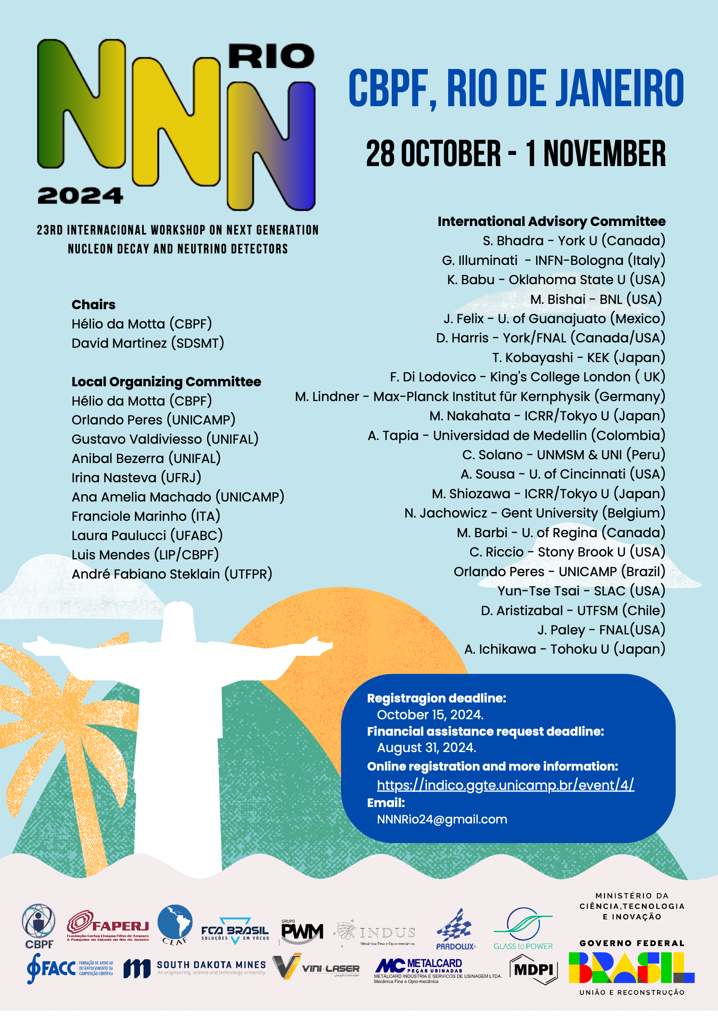
Closing Remarks
(NNN Steering Committee Report)
Chang Kee Jung
Stony Brook University, SUNY
NNN24 Rio de Janeiro, Nov. 1, 2024

Slide 2
Having an idea is easy Having an excellent/brilliant idea is hard But, executing and realizing an idea can be even harder, especially in this mega-science era

Slide 3
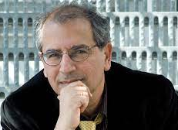
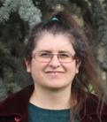
NNN Steering Committee
Asia:
Kenzo Nakamura (1999 – 2008)
Takaaki Kajita (2008 – present)
Europe:
Stavros Katsanevas (2005 – 2022)
Sara Bolognesi (2023 – present )
North America
ckj (Chair)
Late S. Katsanevas
S. Bolognesi

Slide 4
Recent Consideration and Decisions
Increasing the regional rotation:
Past rotation
Asia → Europe → North America
New rotation
Asia → Europe → North America → Latin/South America
NNN19 in Medellin, Colombia and NNN24 in Rio, Brazil
Key considerations
Regional Impact (Host institution, Country, Region)
Inspiring young minds
Increasing the workshop duration from 3 days to 4-5 days
Include dedicated topical parallel sessions
More time for poster sessions
More opportunities for young people
To be discussed (largely leave it to the LOC)
Keep the workshop attendance size modest (~100 - ~150 maximum)
Do not duplicate Neutrino or NuFACT → limited available venues/locations

Slide 5
NNN Workshop Series
NNN99-Stony Brook
NNN00-Irvine (mini-workshop)
NNN00-Fermilab (mini-workshop)
NNN01-Baton Rouge (mini-workshop)
NNN02-CERN
NNN05-Aussois (France)
– Start Rotating Host Region
(Europe, North America, Asia)
NNN06-Seatle (USA)
NNN07-Hamamatsu (Japan)
NNN08-Paris (France)
NNN09-Estes Park (USA)
NNN10-Toyama (Japan)
NNN11-Zurich (Switzerland)
NNN12-Fermilab (USA)
NNN13-Kashiwa (Japan)
NNN14-Paris (France)
NNN15-Stony Brook (USA)
NNN16-Beijing (China)
NNN17-Warwick (UK)
NNN18-Vancouver (Canada)
NNN19-Medellin (Colombia)
NNN22-Hida (Japan)
NNN23-Procida (Italy)
NNN24-Rio (Brazil)
NNN25-Sudbury (Canada)
Provides an international forum for cooperation, coordination and collaboration among the next generation large nucleon decay and neutrino detector community

Slide 6
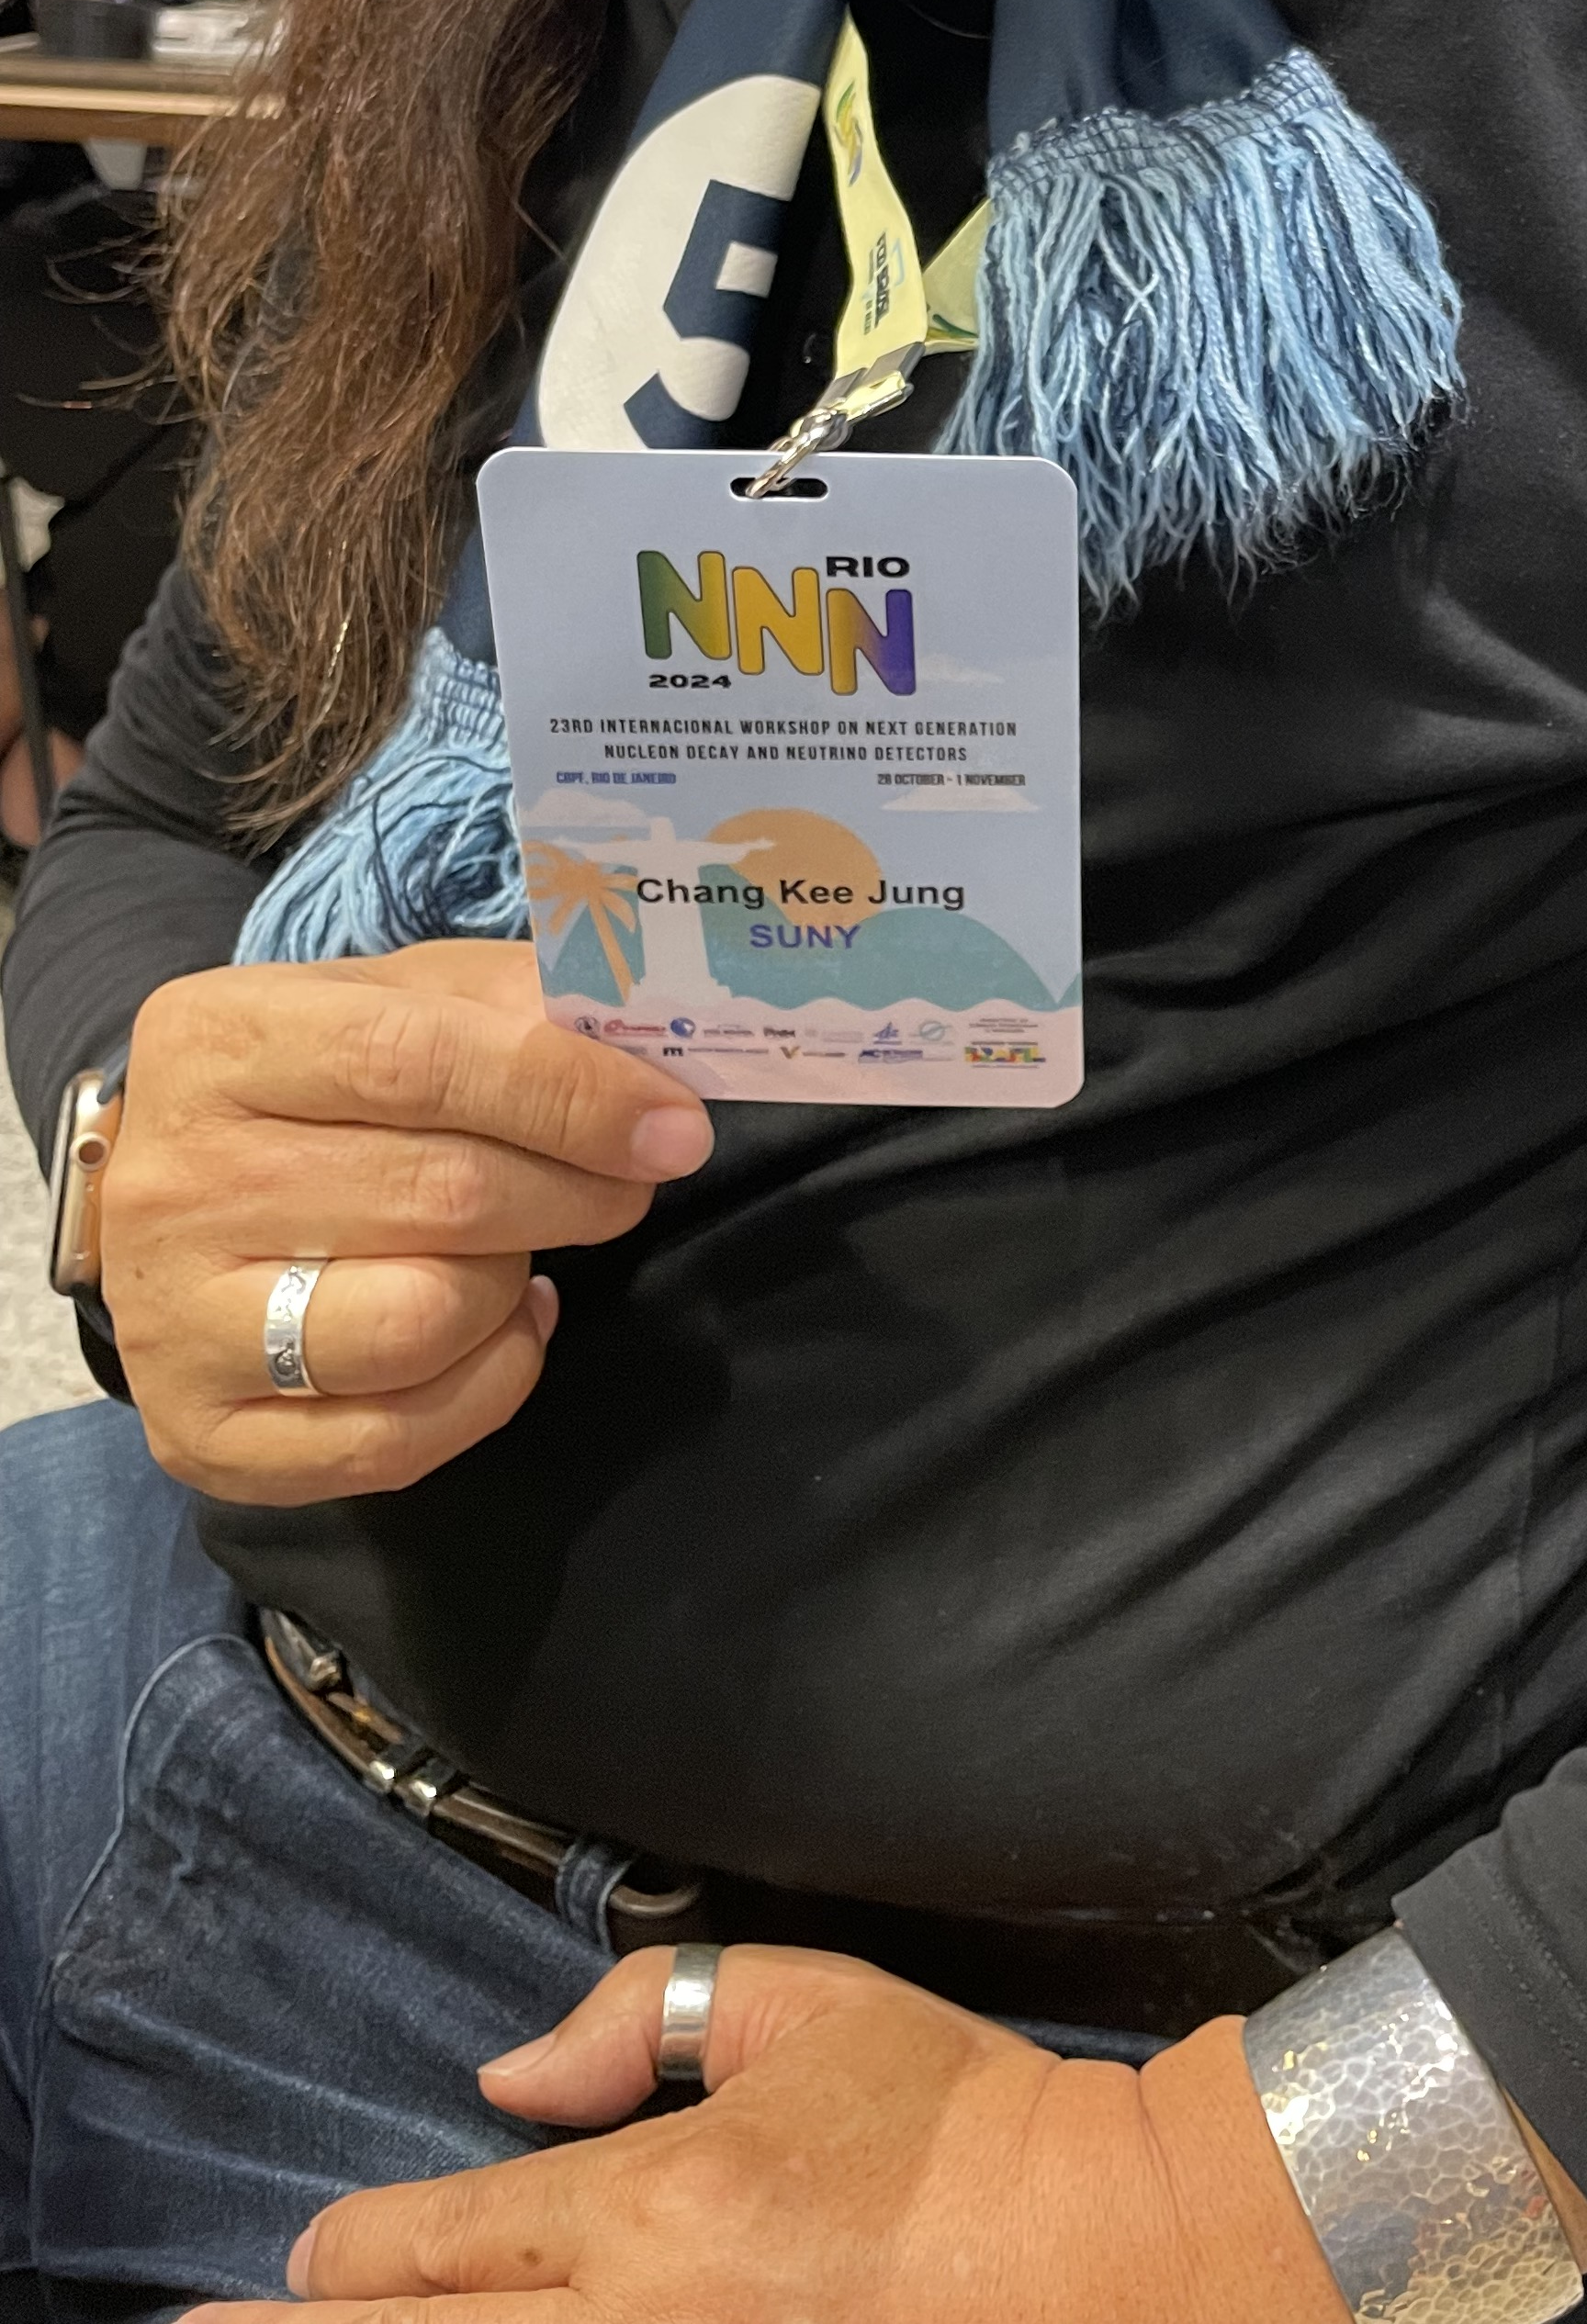
Excellent and highly successful workshop
High quality presentations and major progresses reported
Many presentations by the people from local and nearby regions
Magnificent Rio
Wonderful and cozy workshop venue
Great coffee breaks at the garden
The best name tag ever!

Slide 7
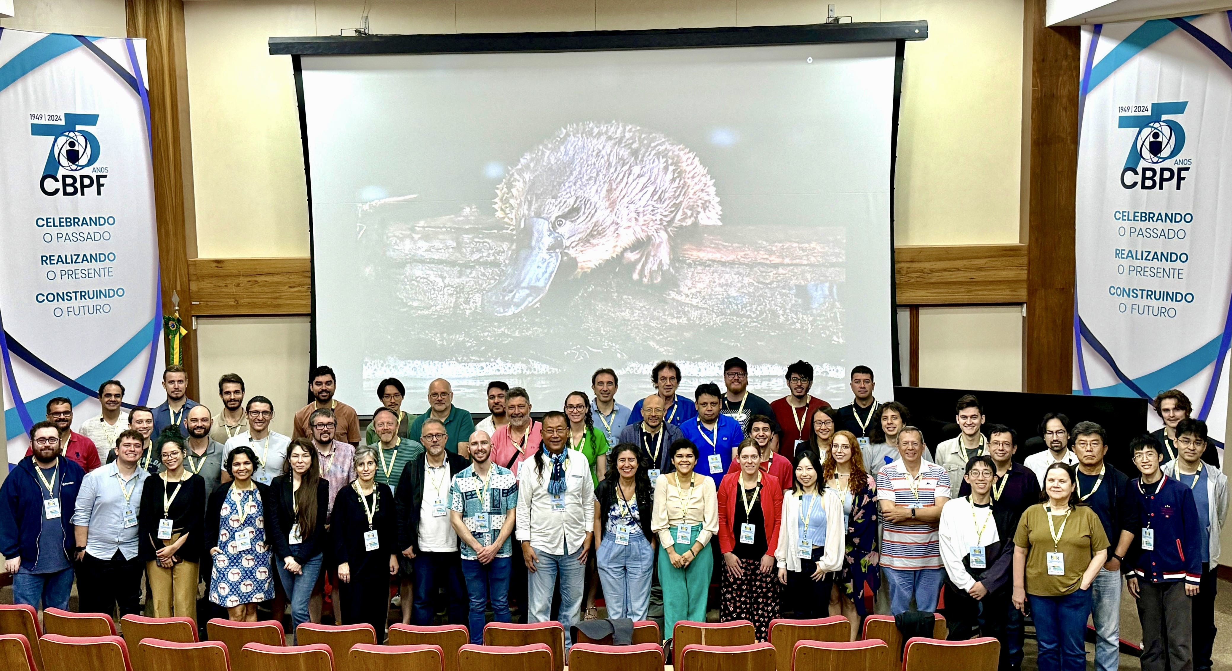
NNN24-Rio Workshop Photos

Slide 8
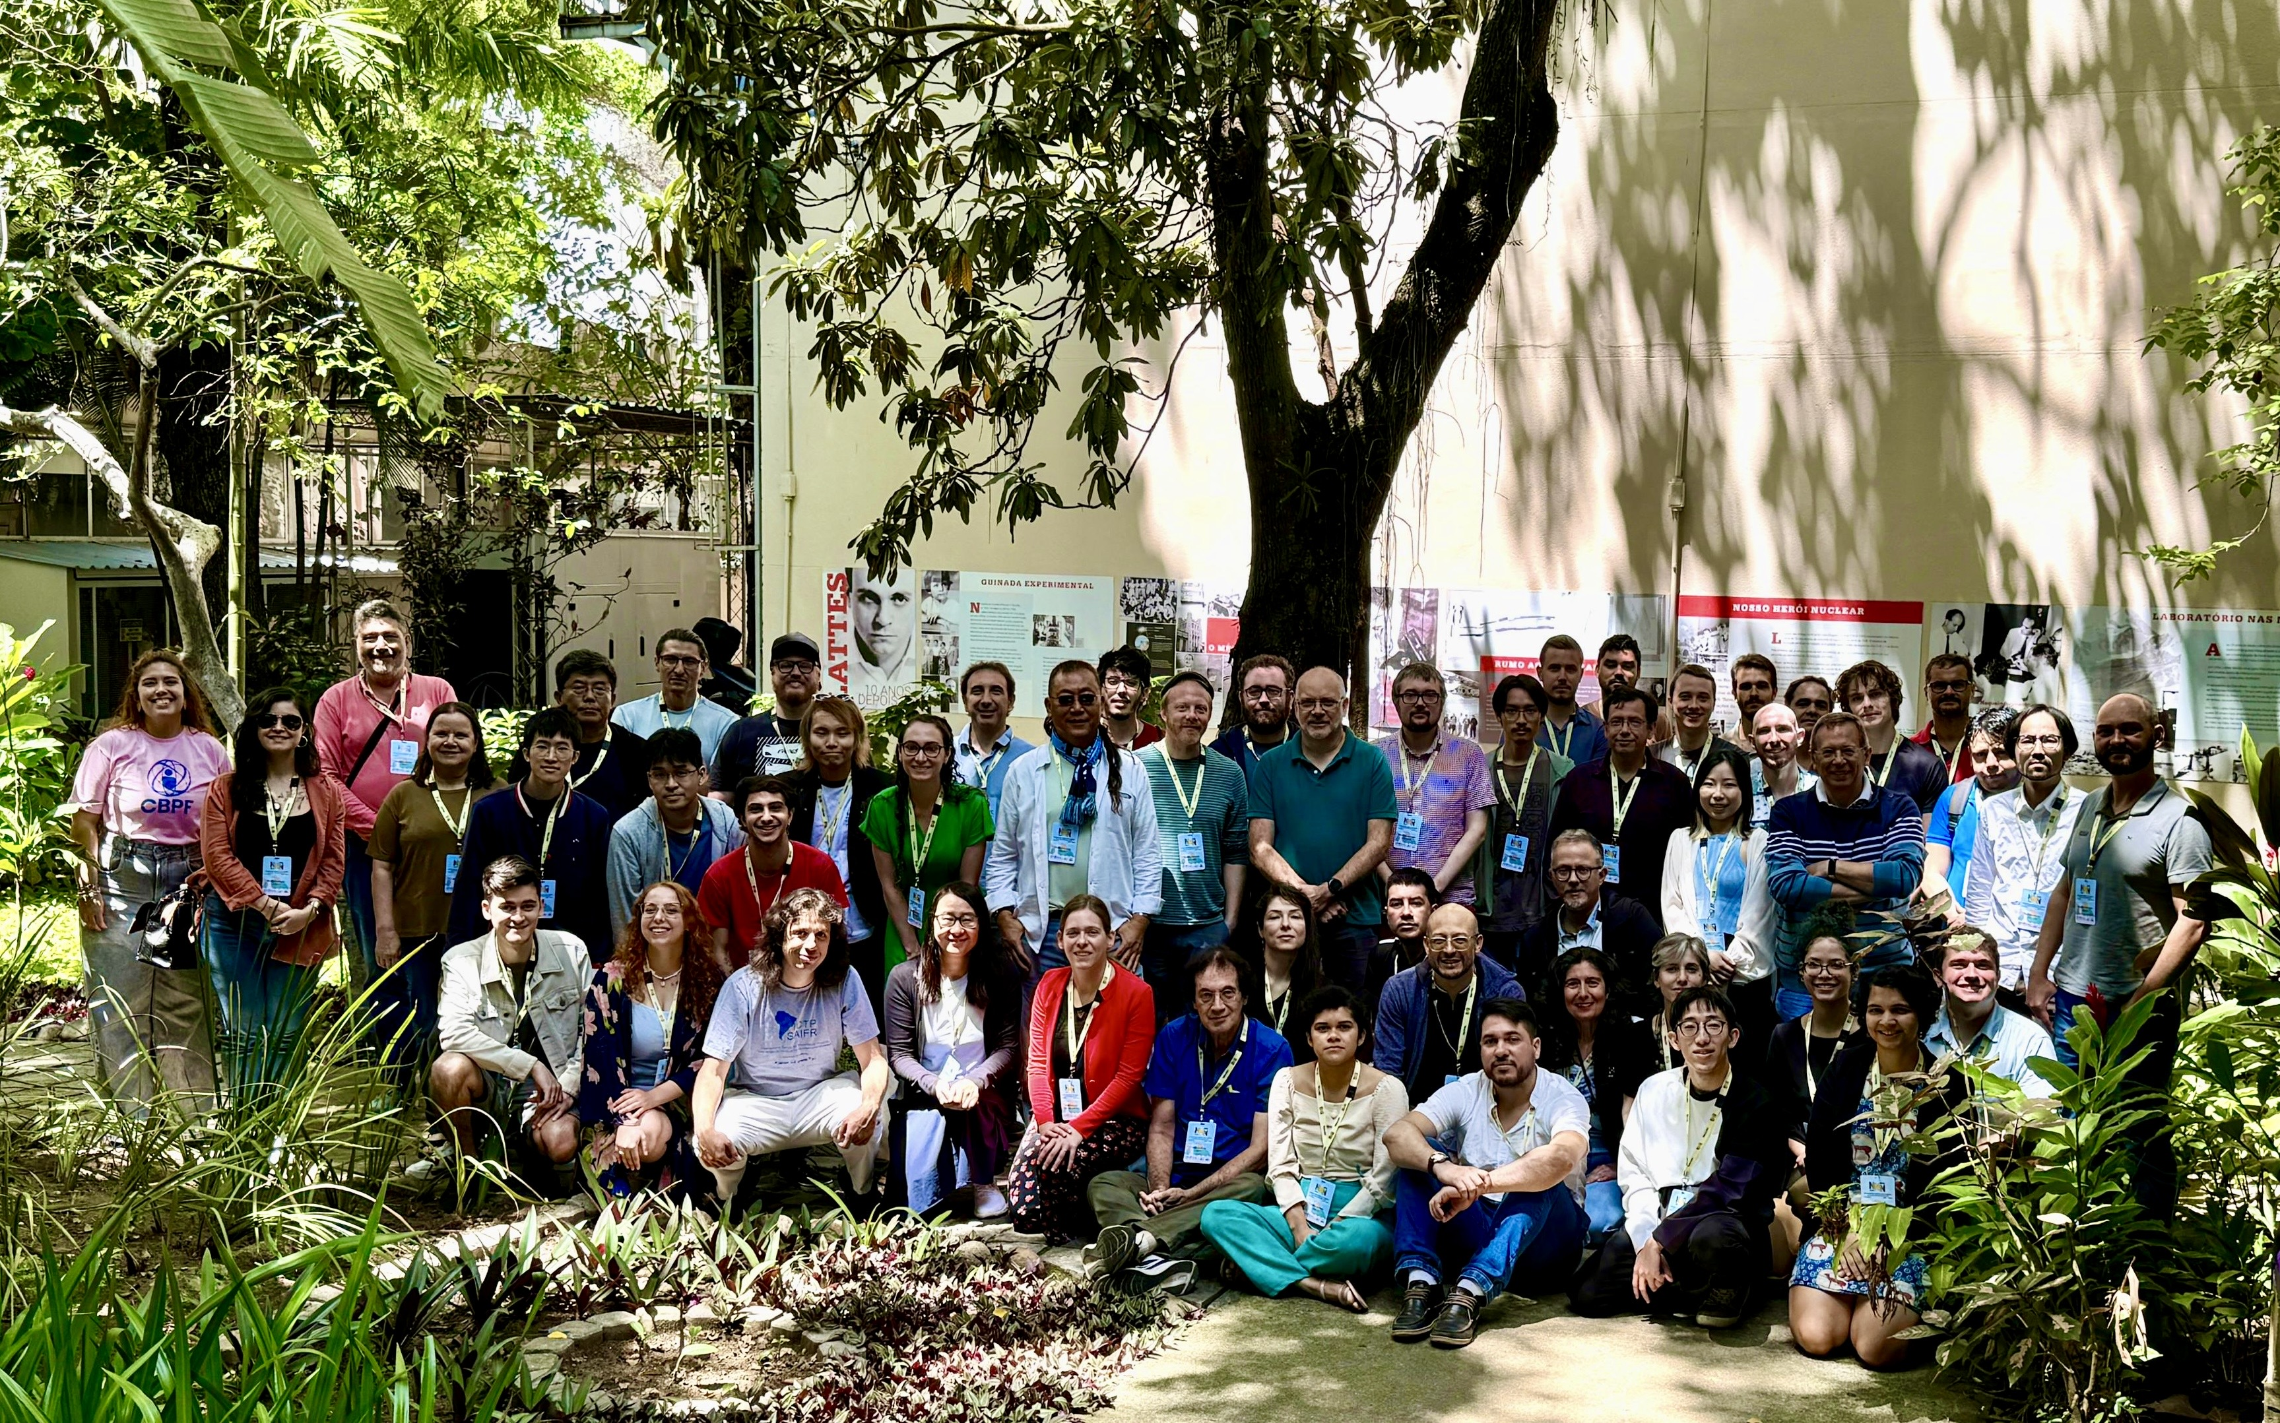
NNN24-Rio Workshop Photos

Slide 9
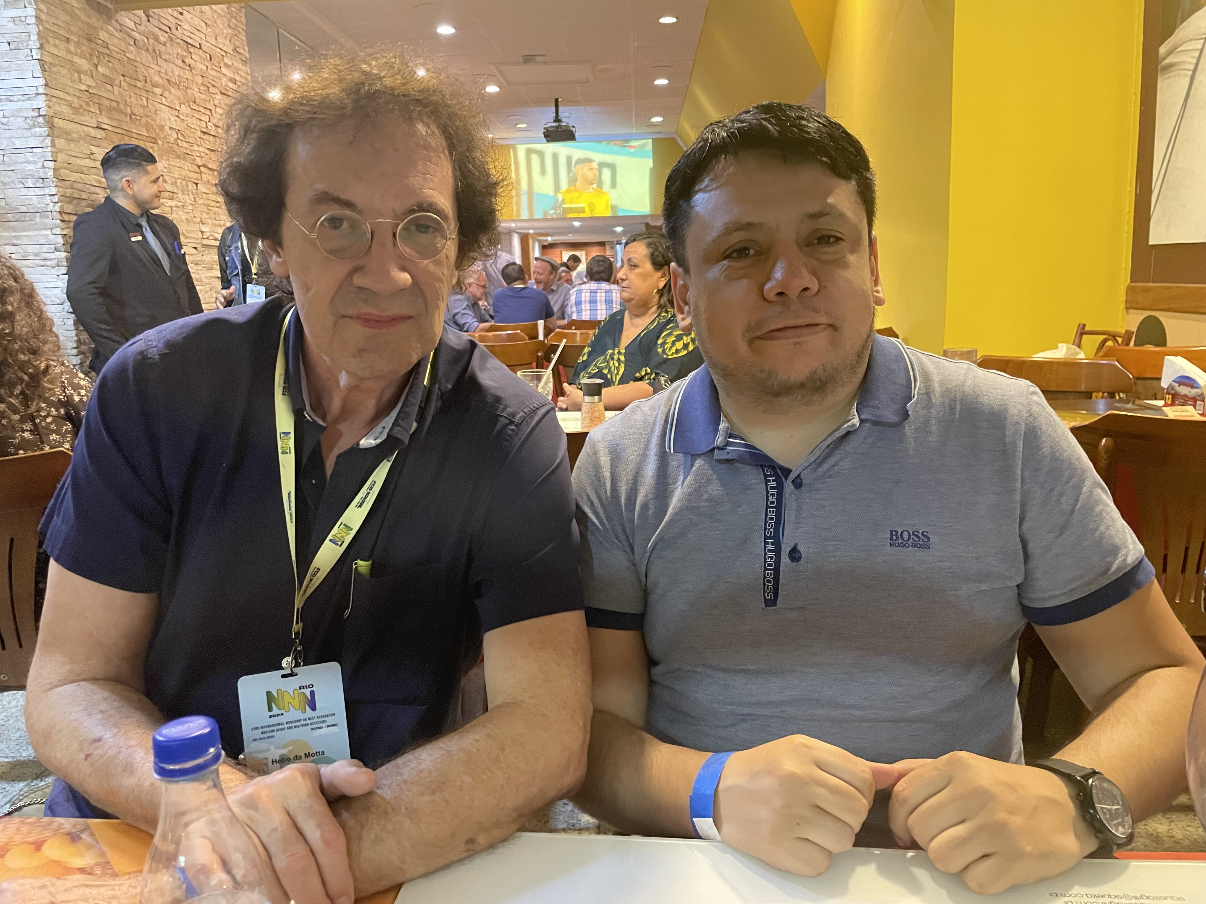
Many Thanks To: Local Organizing Committee
Hélio da Motta, CBPF (Co-Chair)
David Martinez, SDSMT (Co-Chair)
Orlando Peres, UNICAMP
Gustavo Valdiviesso, UNIFAL
Anibal Bezerra, UNIFAL
Irina Nasteva, UFRJ
Ana Amelia Machado, UNICAMP
Franciole Marinho (ITA)
Laura Paulucci (UFABC)
Luis Mendes (LIP/CBPF)
André Fabiano Steklain (UTFPR)
Secretariat: Sônia Ribeiro, Thaissa Martins and CBPF staff

Slide 10
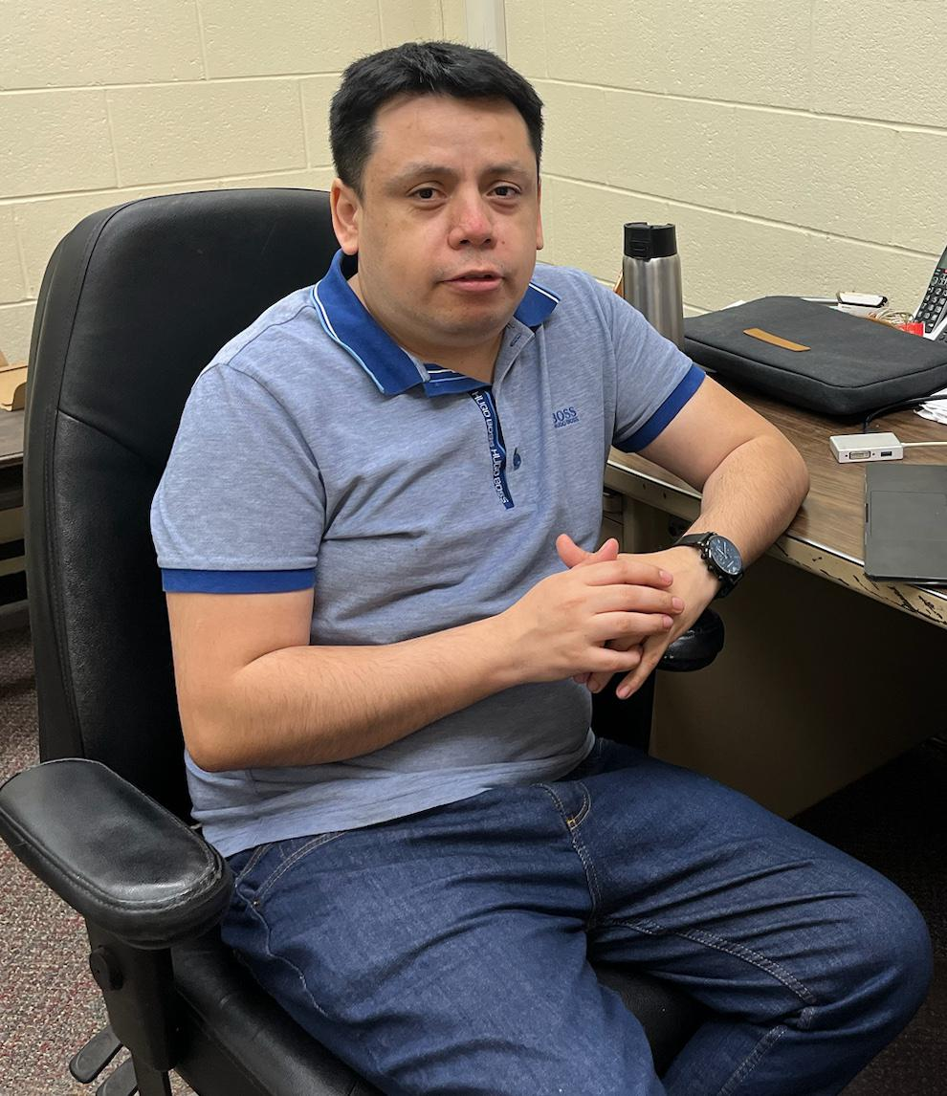
Special Congratulations to David Martinez!
for receiving 2024 US Department of Energy Early Career Award

Slide 11
In addition, many thanks go to the workshop speakers for their excellent presentations, and all participants for their active participation! We hope to see many of you at NNN25 in Sudbury, Canada!

