Slide 1
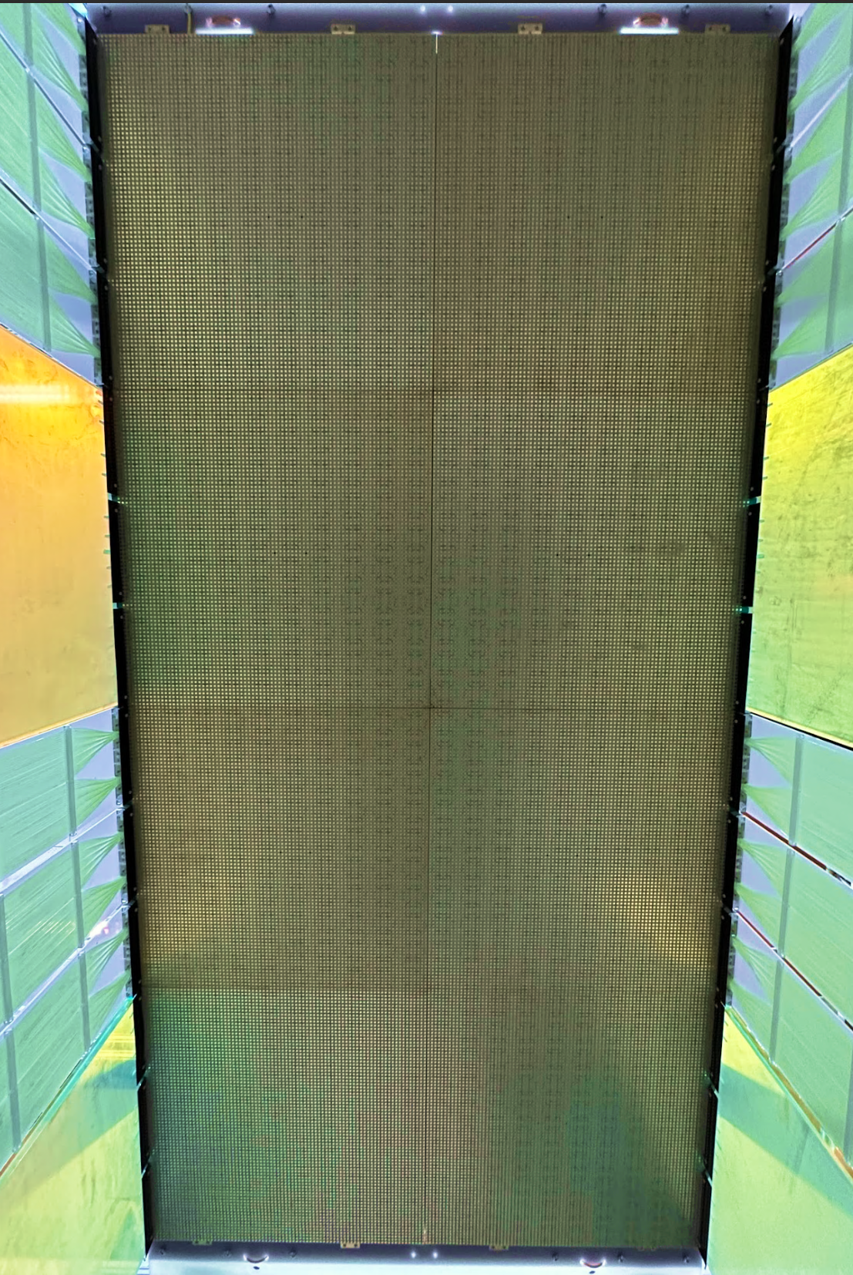
Novel LArTPC technologies for near detectors
Zoya Vallari
Caltech
October 31, 2024

Slide 2





The long & Short of oscillation measurements
Near Detector
Far Detector
neutrino beam
$ν_{μ}$ / ${\overline{ν}}_{μ}$
$ν_{?}$ / ${\overline{ν}}_{?}$
Long baseline O(~100 km)
Near Detector
Far Detector
neutrino beam
$ν_{μ}$ / ${\overline{ν}}_{μ}$
$ν_{?}$ / ${\overline{ν}}_{?}$
Short baseline O(~100 m)
*Not to scale
Zoya Vallari, NNN 2024

Slide 3
The long & Short of oscillation measurements
Near Detector
Far Detector
neutrino beam
$ν_{μ}$ / ${\overline{ν}}_{μ}$
$ν_{?}$ / ${\overline{ν}}_{?}$
Long baseline O(~100 km)
Sample the beam
before oscillations
Measure oscillations
Near Detector
Far Detector
neutrino beam
$ν_{μ}$ / ${\overline{ν}}_{μ}$
$ν_{?}$ / ${\overline{ν}}_{?}$
Short baseline O(~100 m)
*Not to scale
Zoya Vallari, NNN 2024

Slide 4


role of near detectors
NEAR DETECTOR
Event rate
cross-section
oscillation probability
neutrino flux
detector response
FAR DETECTOR
Near Detector provides valuable in-situ cancelation and constraints on:
neutrino flux
cross-section, and
detector uncertainties
*More from Joe Walsh
in tomorrow morning session
Zoya Vallari, NNN 2024

Slide 5
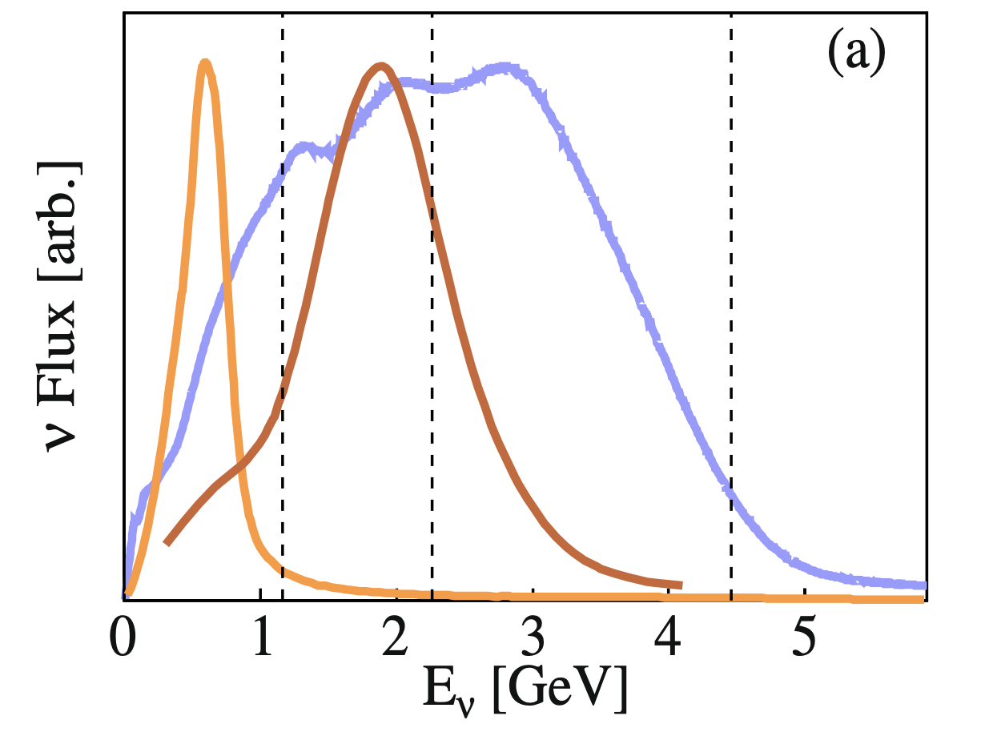
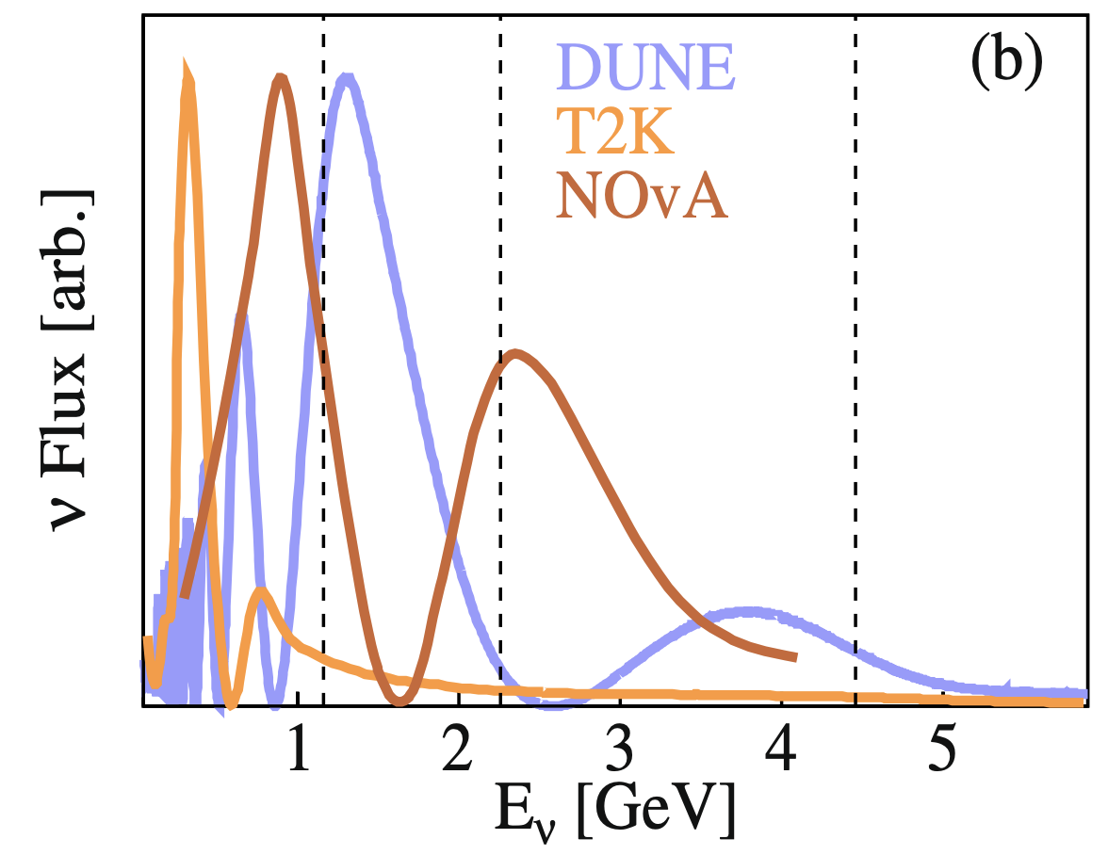
requirements for a near detector?
Nature volume 599, pages565–570 (2021)
Flux at ND
I. Neutrino Flux
Measure the flux: not mono-energetic and not well-understood
Challenge: flux shape differs significantly between the Near and Far detectors due to distance and oscillations
Solution: Movable NDs*
Monitor beam stability
Flux at FD
(with assumed value of oscillation parameters)
*More from Akutsu-san in today’s morning session
Zoya Vallari, NNN 2024

Slide 6
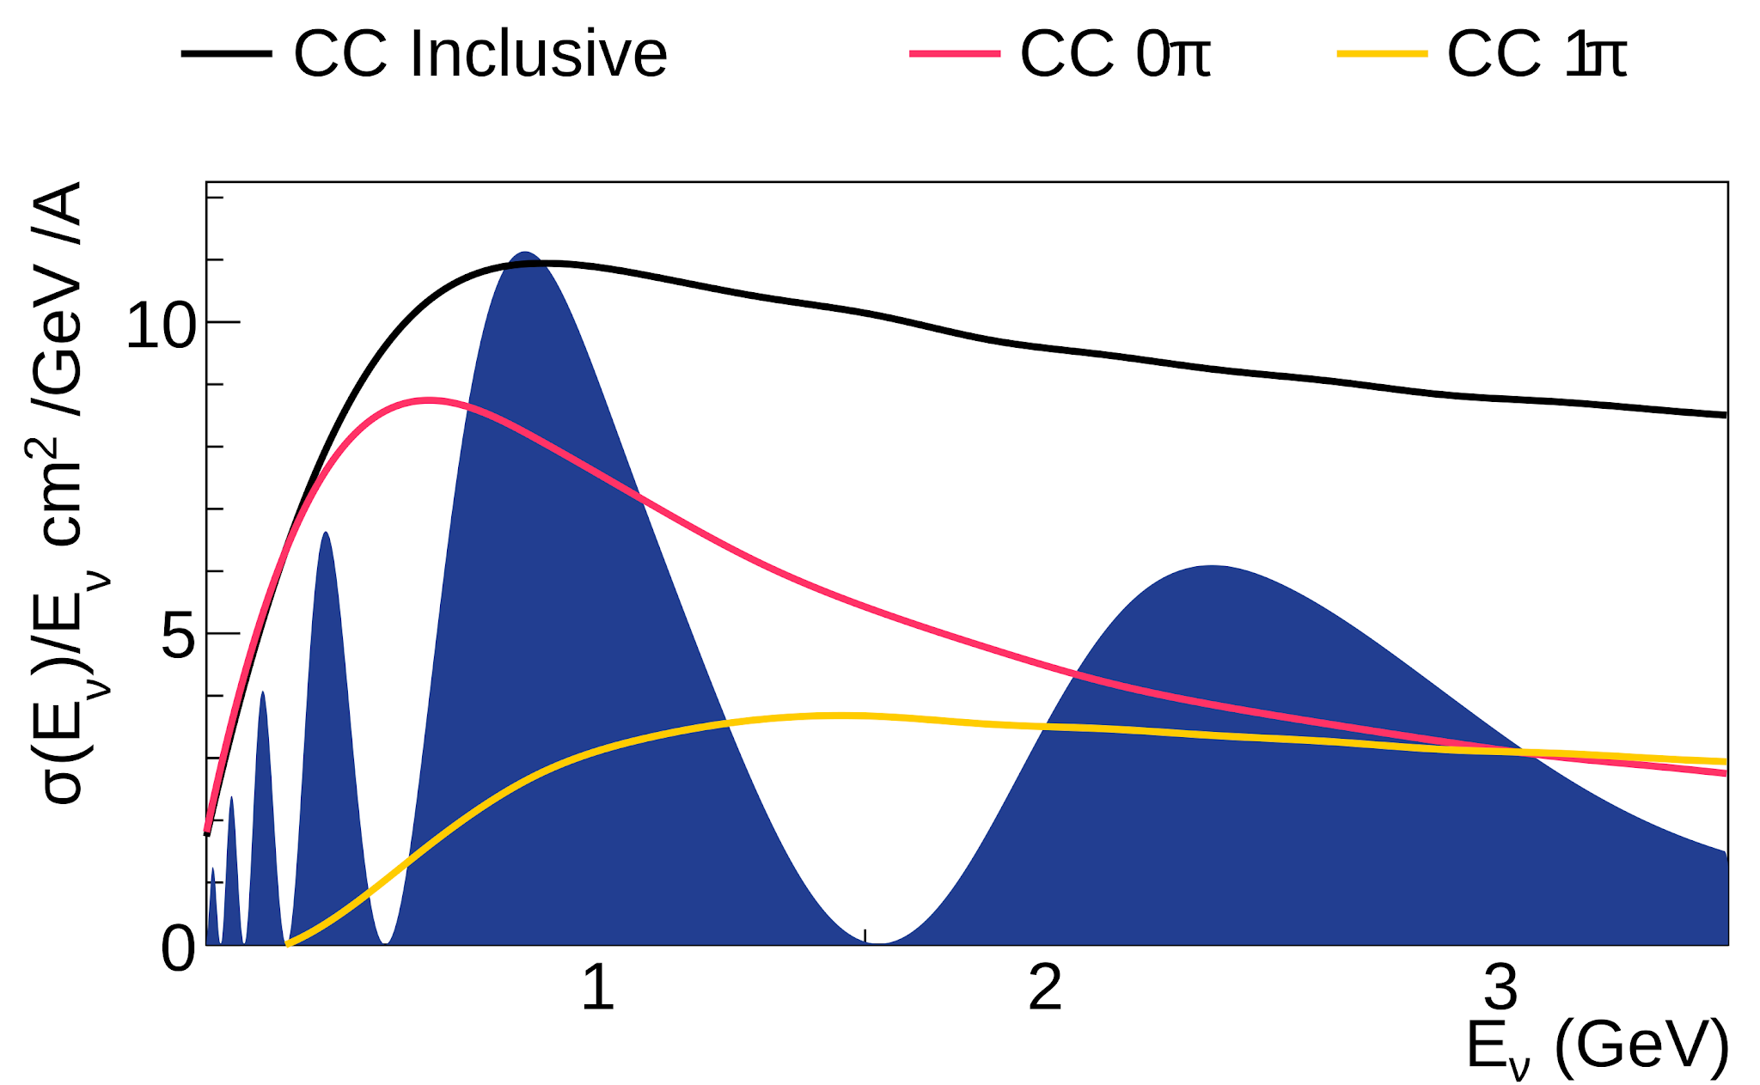
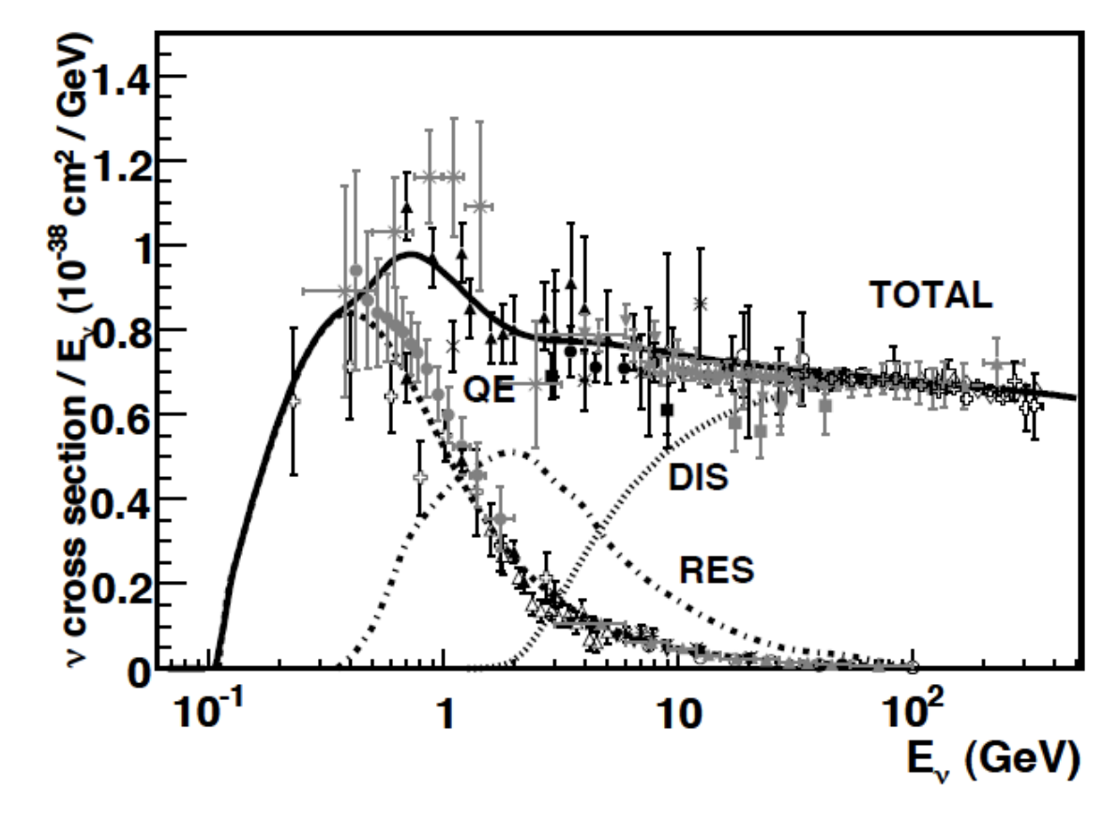
requirements for a near detector?
Image Credit: Luke Pickering
II. Neutrino Cross-Section
Same nuclear target and transferable to FD
Challenge:
Varying flux alters neutrino interactions, as cross-section depends on neutrino energy
Differences in ND efficiency and acceptance shift the kinematic phase space of interactions detected at each site
III. Detector Uncertainties
Similar detector technologies
Challenge: different fluxes, high pile-up at ND
Formaggio and Zeller
Rev. Mod. Phys. 84, 1307
Zoya Vallari, NNN 2024

Slide 7
LArTPC: A short primer
Zoya Vallari, NNN 2024

Slide 8
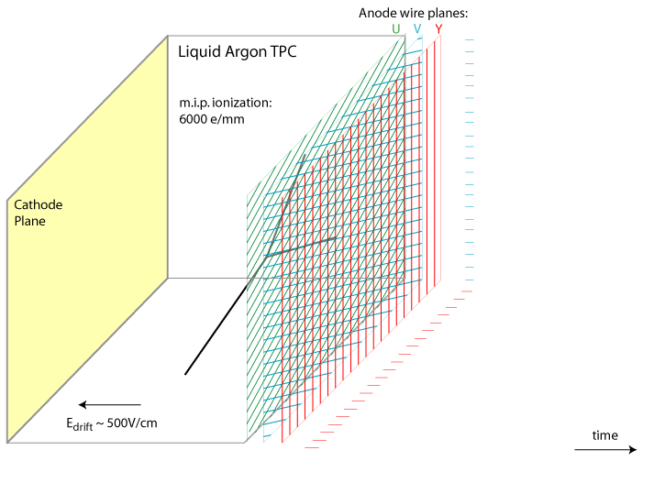
What is^ LArTPC?
a Classical
Neutrino interaction in LAr produces ionization and scintillation light
The ionization charge drifts in a uniform electric field to finely segmented wire planes.
Multiple wire orientations give independent views of the same event.
Image credit: WirecellTeam, BNL

Slide 9
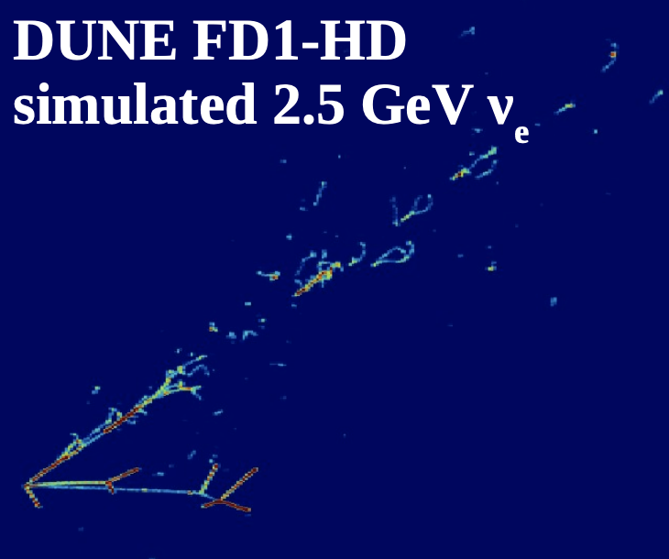
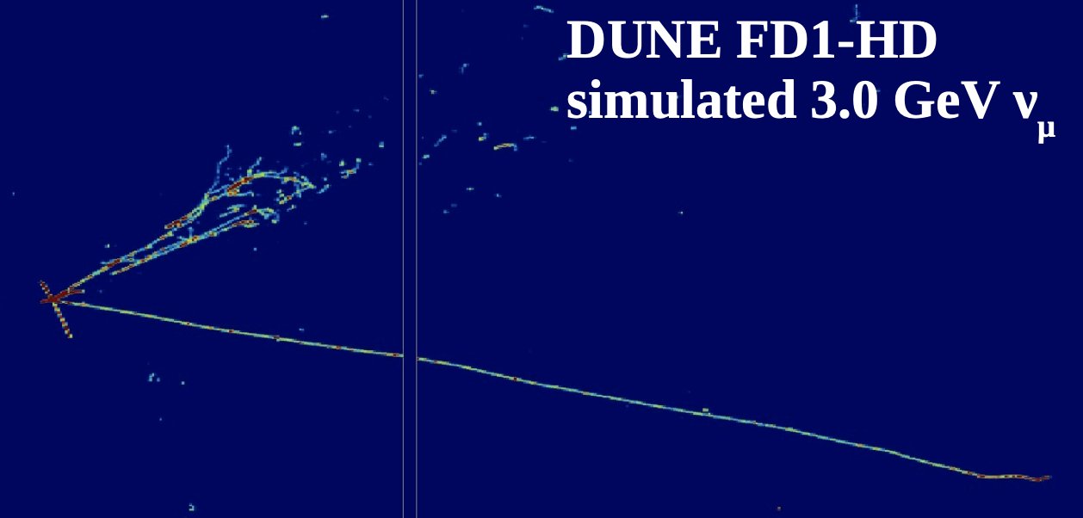
Why LArTPCs?
ν_{e} + Ar → e p p π⁻
Exquisite imaging for flavor ID and energy reconstruction.
Excellent particle identification and spatial resolution.
Low thresholds for charged particles enables precise reconstruction of lepton and hadronic energy.
ν_{μ} + Ar → μ p p π⁰

Slide 10
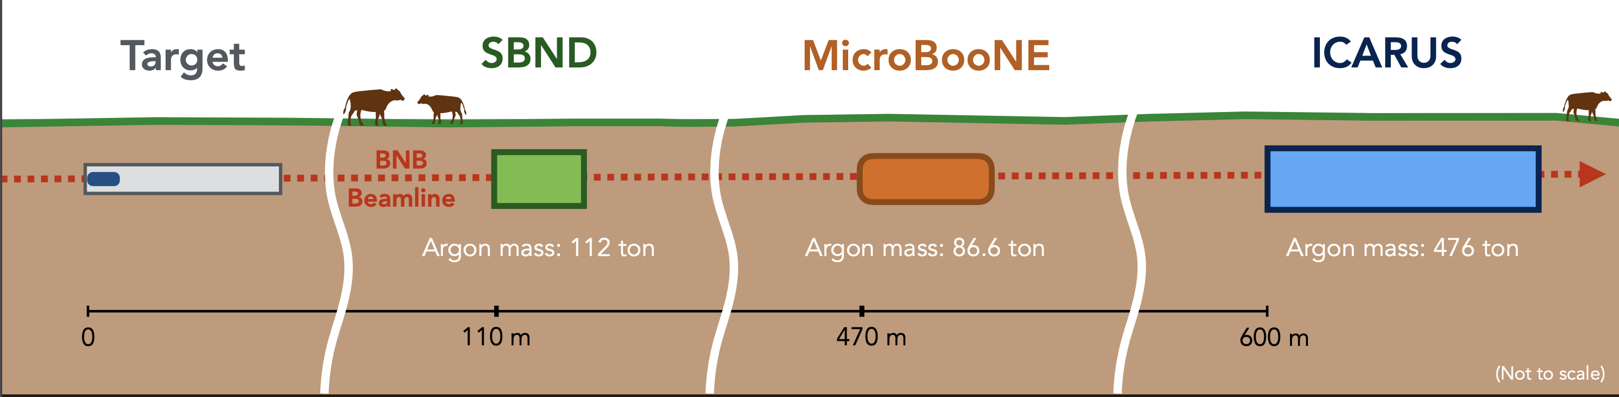
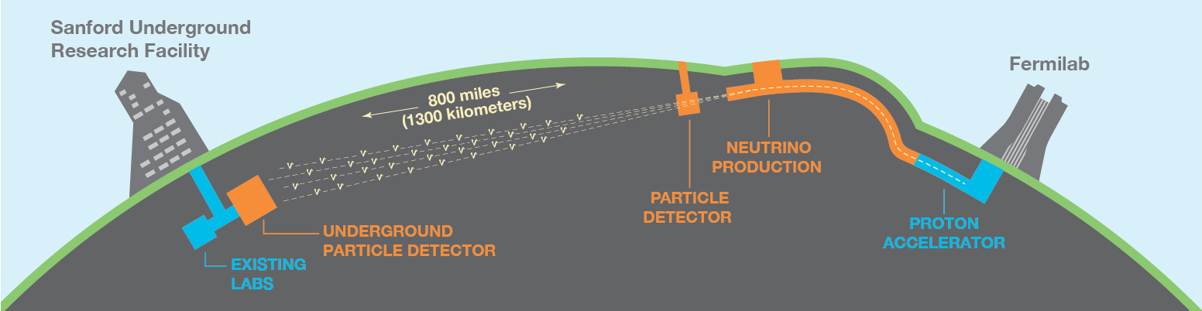
LArtPC Program at Fermilab
Image Credit: Marco Del Tutto

Slide 11
near detector for short-baseline
Image Credit: Marco Del Tutto
Zoya Vallari, NNN 2024

Slide 12
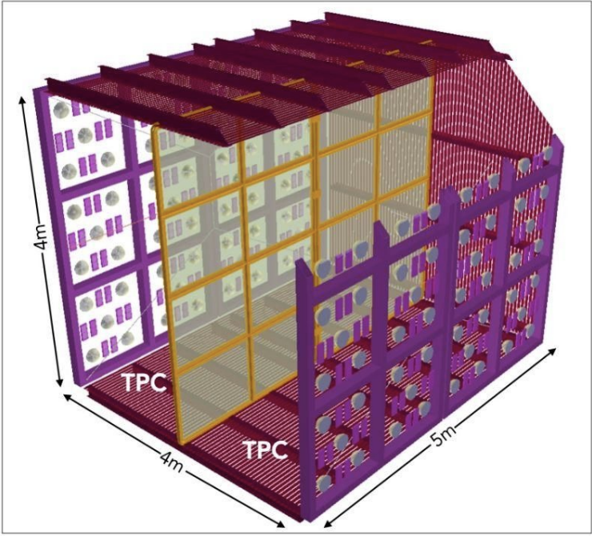
highlights of sbnd design
More details in the talk
by Gustavo Valdiviesso yesterday!
Two TPCs that share a central HV cathode (CPA)
Four anodes (APA) with 3 wire planes each
1 collection (vertical), 2 induction (±60°)
3 mm spacing both inter-wire and inter-planes
Photon Detection System (PDS)
120 8'' PMTs
192 X-ARAPUCAs (developed in Brazil)
Reflective foil panels coated with wavelength shifter embedded into the CPA
Light-yield ≥100 pe/MeV
Cosmic Ray Tagger (CRT)
Summarized from slides by Gustavo Valdiviesso
Zoya Vallari, NNN 2024

Slide 13
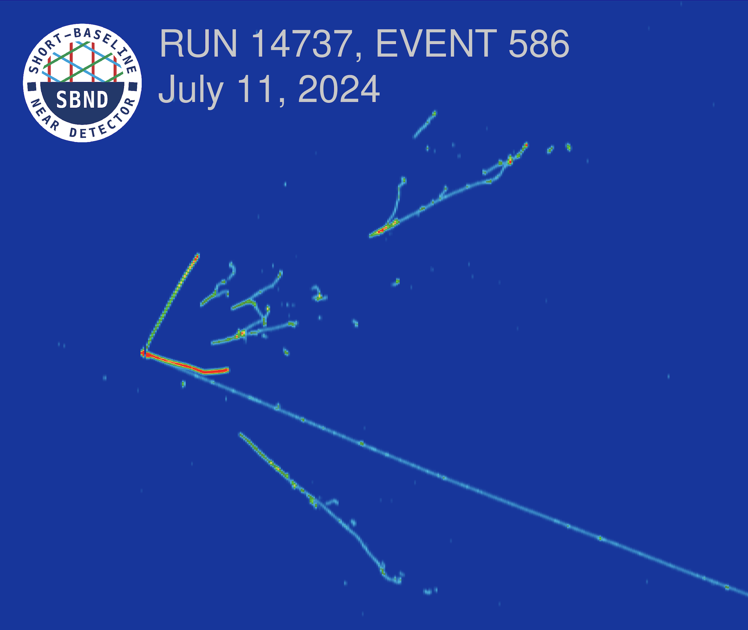
SBND is taking beautiful data, and we are looking forward to seeing first results!
Zoya Vallari, NNN 2024

Slide 14
near detector for long-baseline
Zoya Vallari, NNN 2024

Slide 15
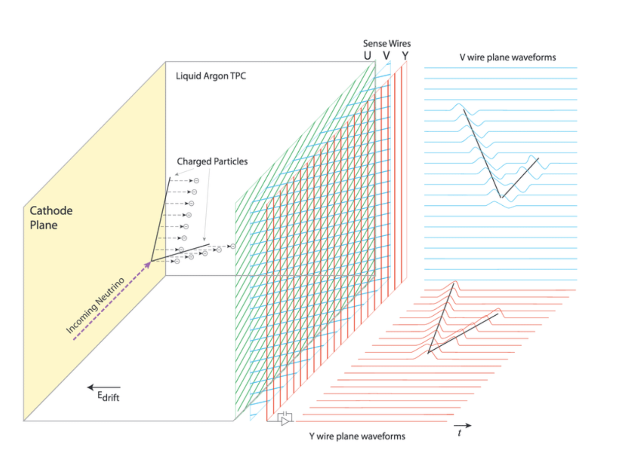
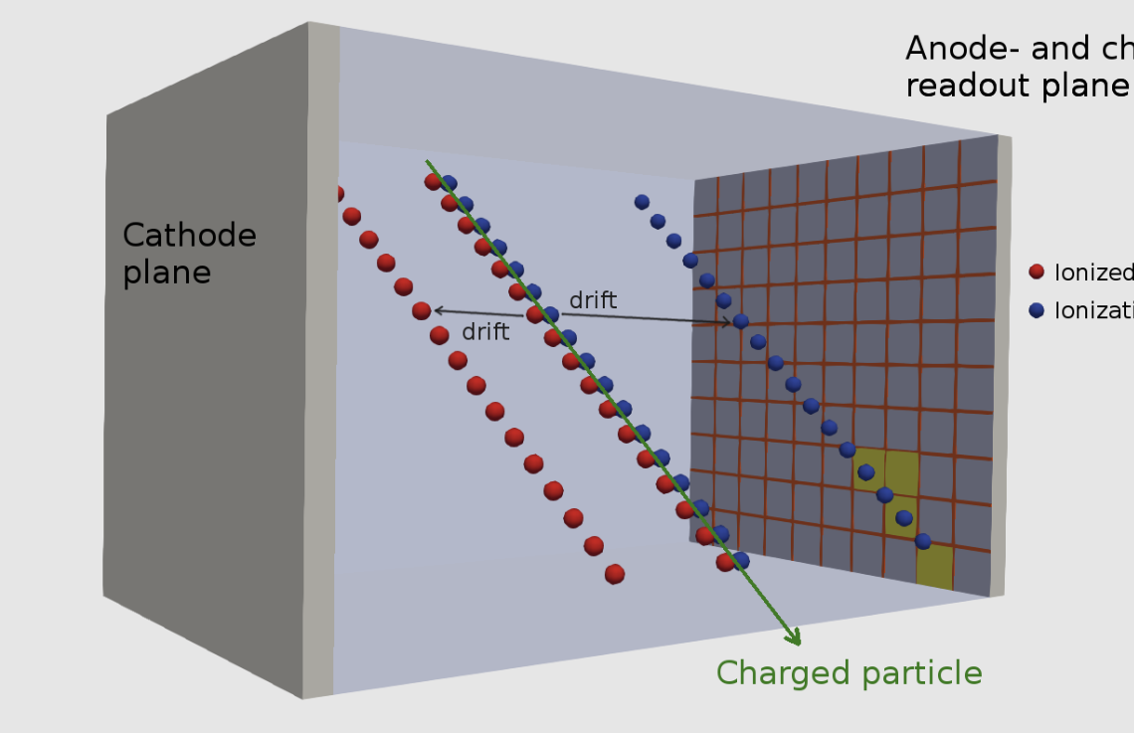

next generation LArTPCs But Why?
Pixel readout
Anode plane
Zoya Vallari, NNN 2024

Slide 16
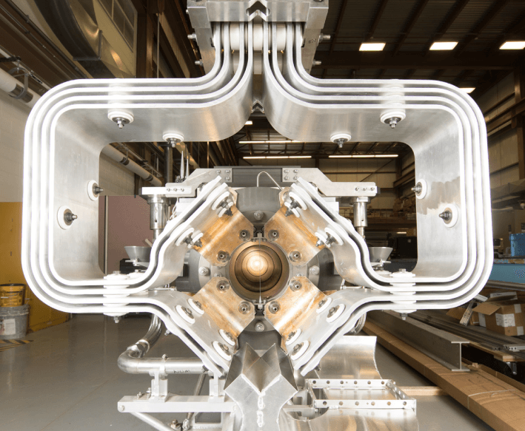
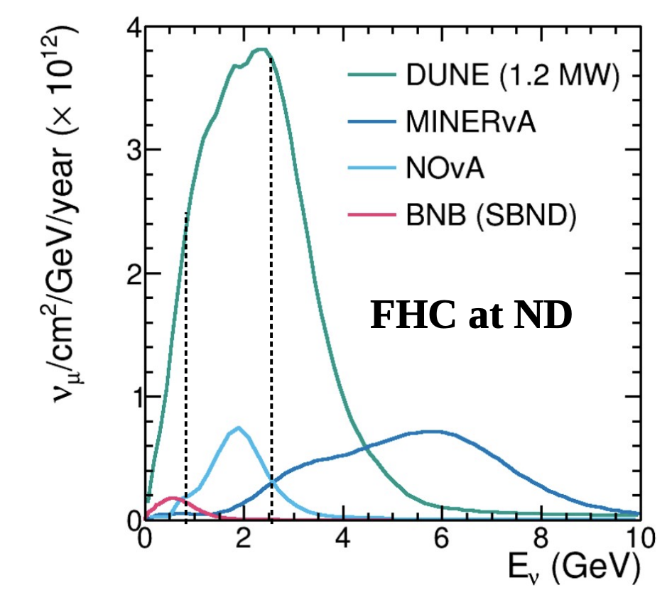
LBNF Pip-II Beam: most powerful accelerator neutrino beam in the world
Neutrino-mode beam at ND
Plot Credit: Luke Pickering
Zoya Vallari, NNN 2024

Slide 17
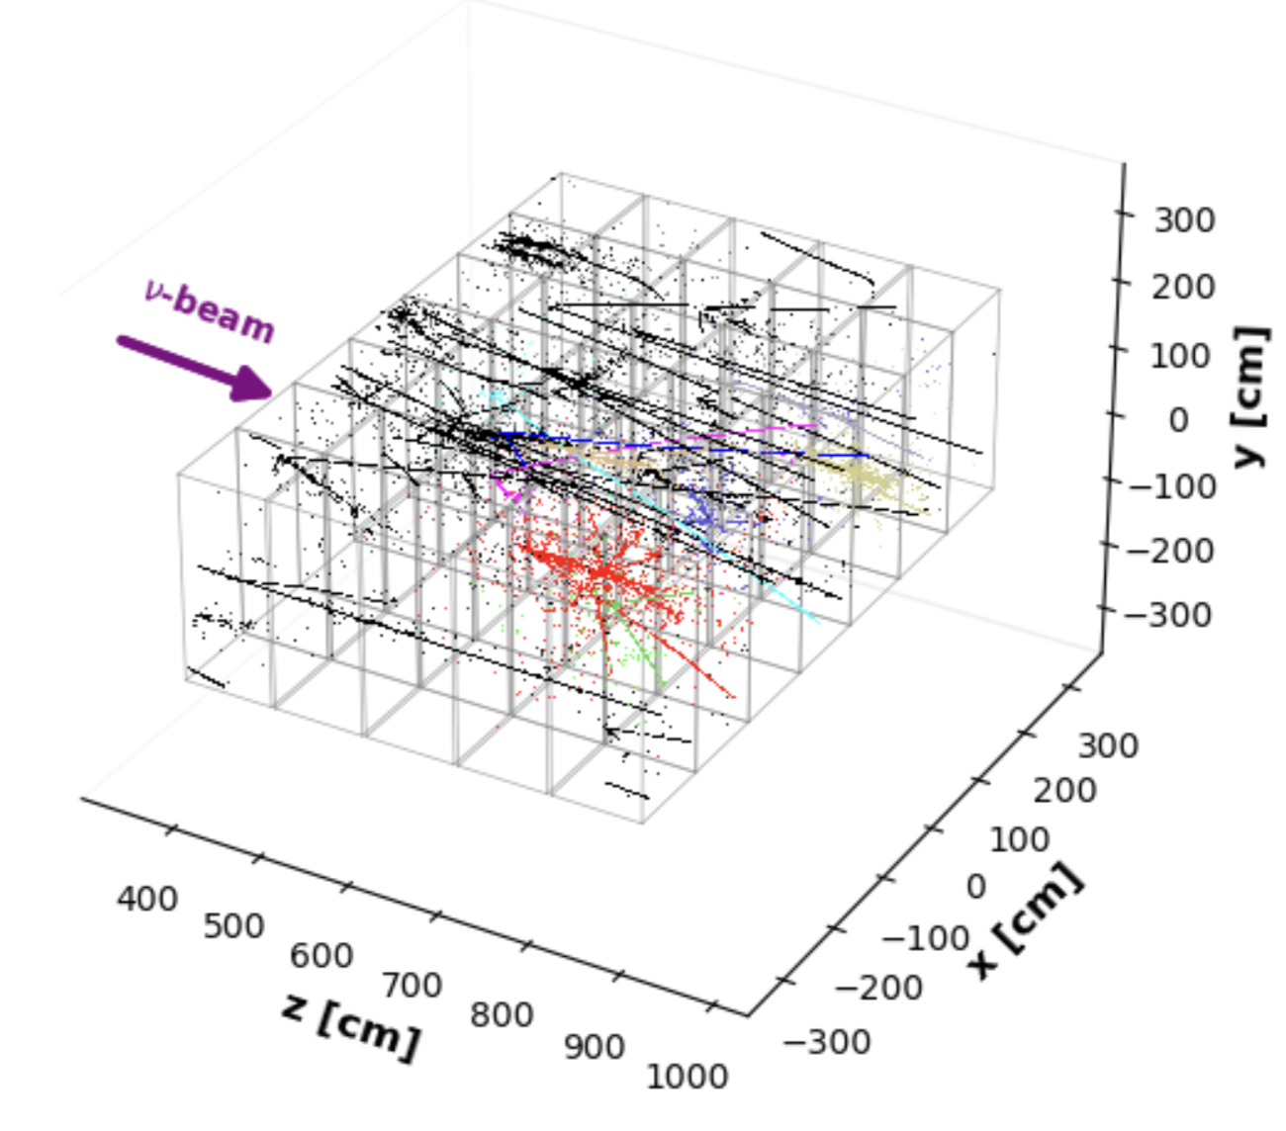
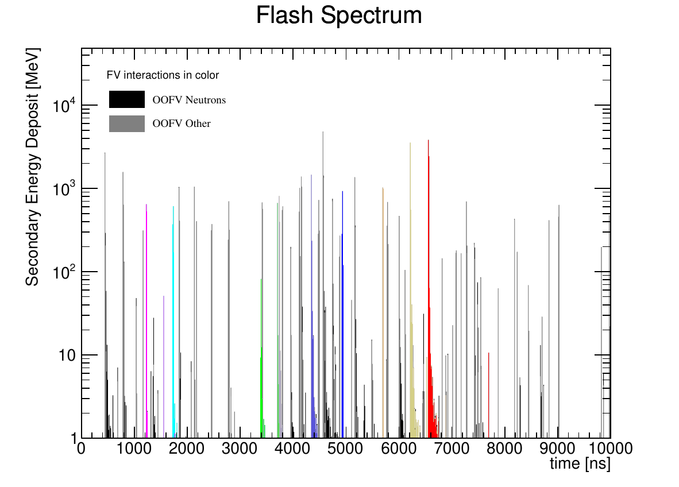
ND LArTPC in the DUNE beam
~50 ν interactions in a single 1.2 MW LBNF beam spill
Single neutrino interaction

Slide 18
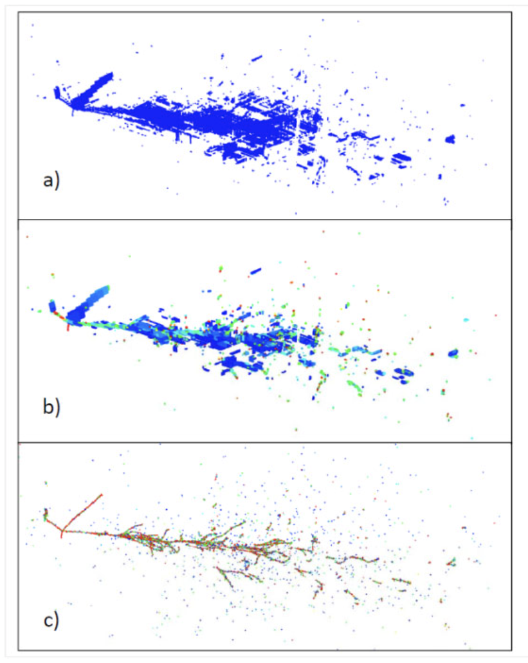
LArTPCs in high-pile up environment
X. Qian et al 2018 JINST 13 P05032
Classical
Raw time &
geometry based
reconstruction
Processed signal and
sophisticated reconstruction
algorithms
Conventional TPCs infer 3D reconstruction by combining 2D views.
Ambiguities in projective wire readout aggravate in high multiplicity environment
True simulated
event

Slide 19
how to maintain signal fidelity in a high occupancy environment?
Zoya Vallari, NNN 2024

Slide 20
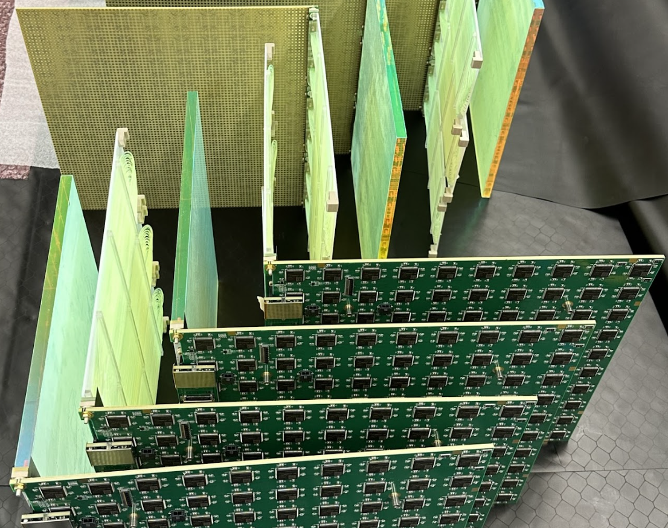
A next generation of lartpc
Pixelated Charge readout
Modular TPC
Optical Segmentation
Low-profile field cage
Zoya Vallari, NNN 2024

Slide 21
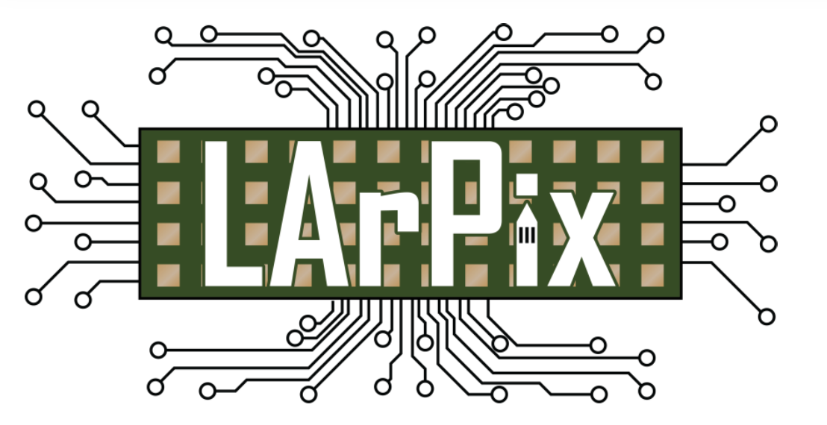

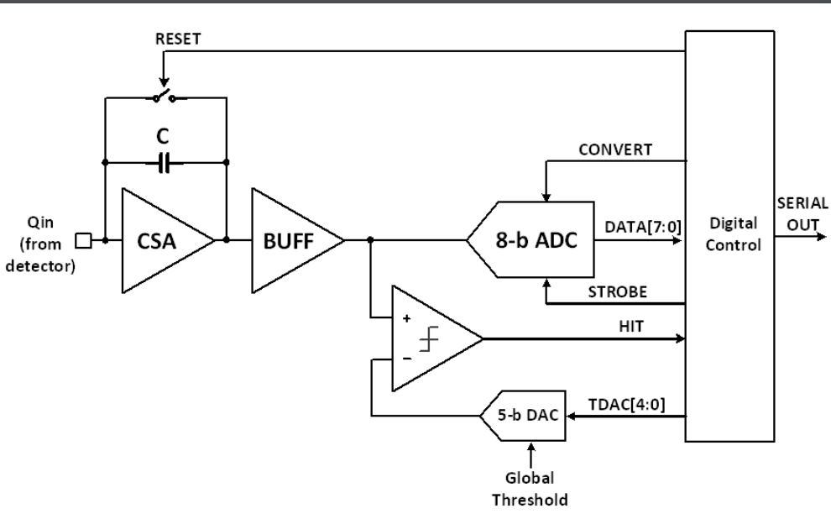
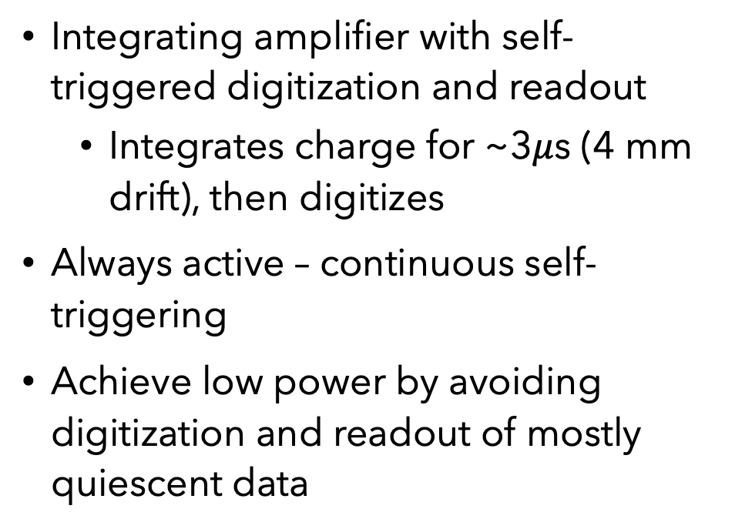
pixelated charge readout
Dan Dwyer et al. JINST 13 (2018) P10007
Integrating amplifier with self-triggered digitization and readout
Integrates charge for ~3$μ$s (4 mm drift), then digitizes
Always active – continuous self-triggering
Achieve low power by avoiding digitization and readout of mostly quiescent data
Standard SAR Digitizer
Charge-sensitive amplifier
Self-triggering discriminator
Not covered*: Q-Pix technology by Dave Nygren (UTA) and Yuan Mei (LBNL) arXiv: 1809.10213

Slide 22
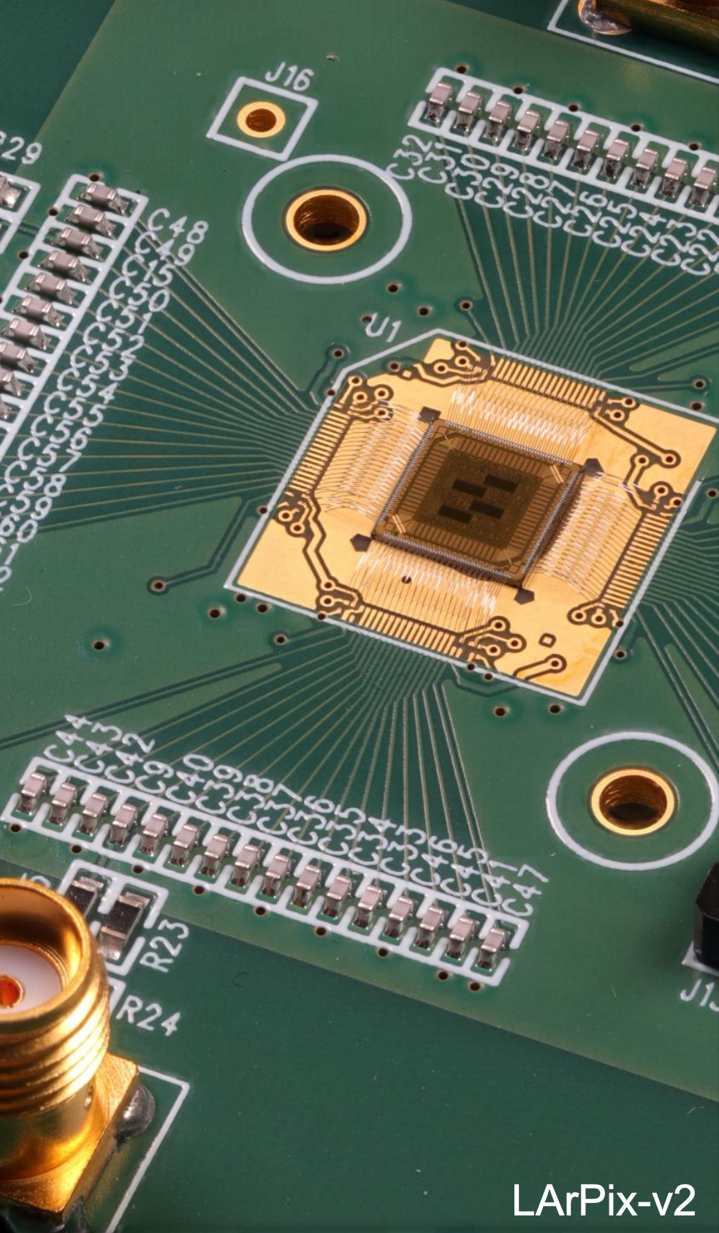
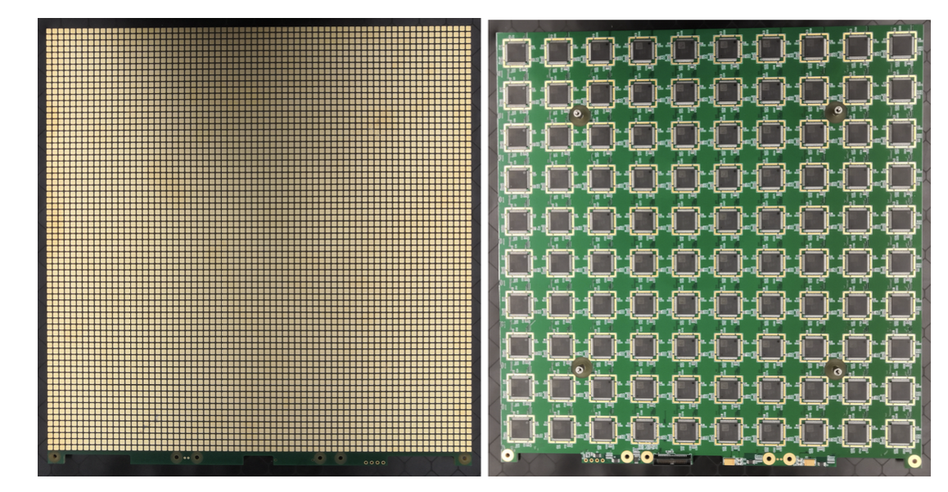
pixel tiles
32 cm x 32 cm large-format mixed signal PCB
Front : 4900-pixel pads with 4.4 mm pixel pitch
Back: 10x10 grid of LArPix ASICs
Mass production by commercial vendors
~0.10 USD/channel
LArPix-v2a ASIC
Notes:
PCB: Printed Circuit Board

Slide 23
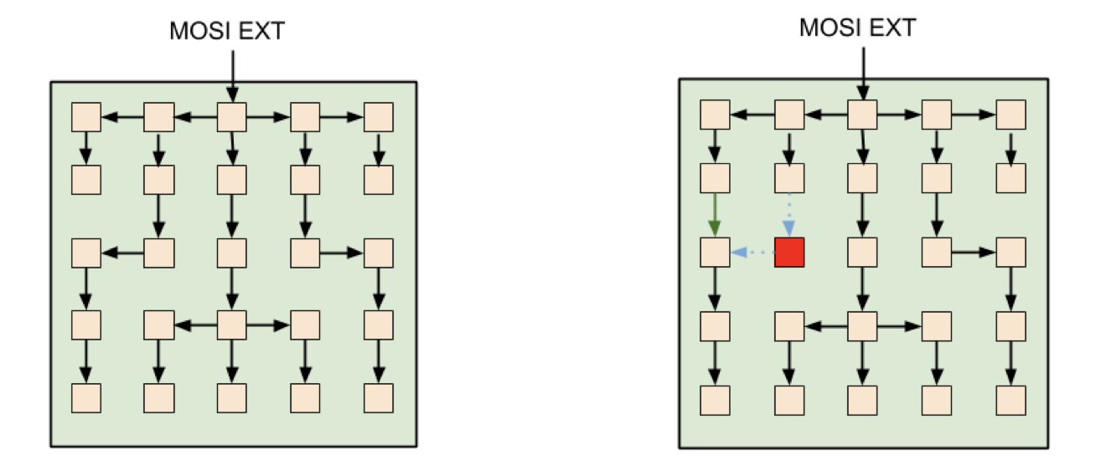
dynamic hydra i/o configuration
Serial I/O data rate is slow (~5 Mb/s per I/O channel) to limit digital power
Hydra I/O: novel adaptable chip-to-chip communication to avoid single point failures
Notes:
In Hydra-I/O, the system’s networks can be automatically reconfigured to route around individual failed ASICs without compromising the overall network, which ensures system reliability in extreme environments like the ND.
Modest data volumes: ~1 MB/s per square meter of anode in surface cosmic-ray flux
Hydra I/O is a system to create ad-hoc, software-defined networks of Application-Specific Integrated Circuits (ASICs) that can be automatically reconfigured to route around individual failed ASICs without compromising the overall network.

Slide 24
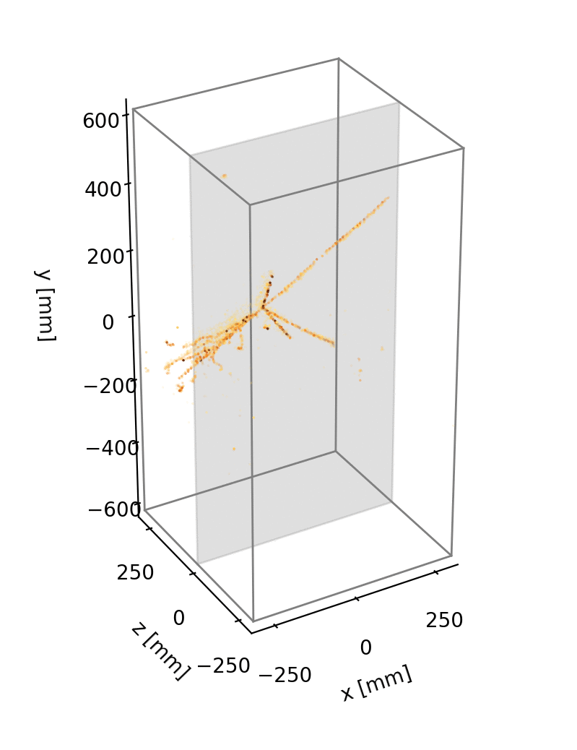
native 3D imaging
Unambiguous tracking of charged particles
True 3D imaging of TPC ionization
Zoya Vallari, NNN 2024

Slide 25
Short interlude: Next gen detectors require next gen software
Zoya Vallari, NNN 2024

Slide 26

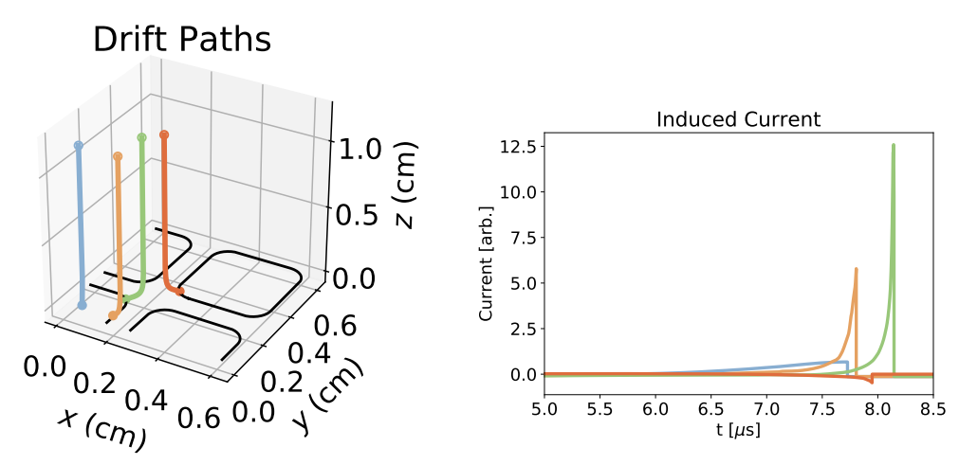
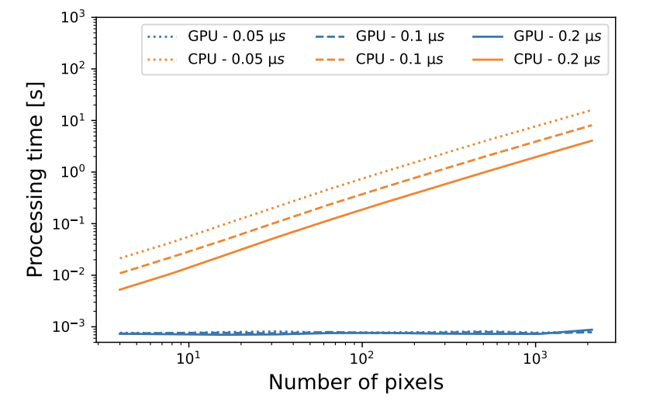
pixelated Design is well-suited for GPU processing
A. Abed Abud et al 2023 JINST 18 P04034
Highly-parallelized simulation of a pixelated LArTPC on a GPU
Advanced simulation leveraging highly parallelized processing.
Consistent processing time even as the number of pixels increased.
Benchmarked against cosmic data, demonstrating its high maturity.
Machine-learning based reconstruction integrate seamlessly to GPU computing.

Slide 27

modular TPC with optical segmentation
To simplify charge-light signal matching combinatorics, modularize the TPCs and add optical segmentation.
Creates short drift distances (~50 cm) with contained scintillation light
Single neutrino interaction

Slide 28
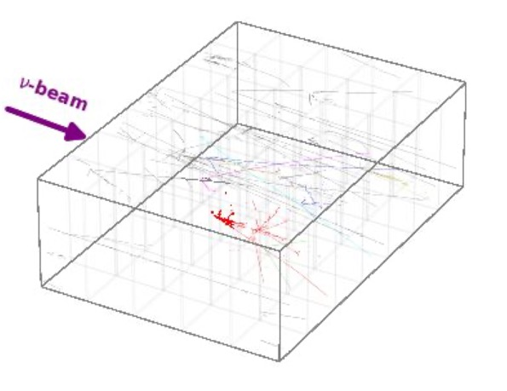
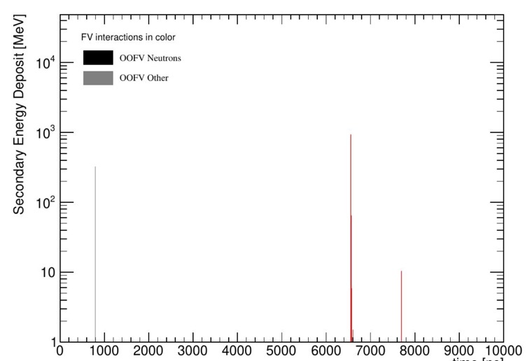
modular TPC with optical segmentation
To simplify charge-light signal matching combinatorics, modularize the TPCs and add optical segmentation.
Creates short drift distances (~50 cm) with contained scintillation light
Light flashes in a single TPC
Charge deposit in a single TPC
Single neutrino interaction

Slide 29
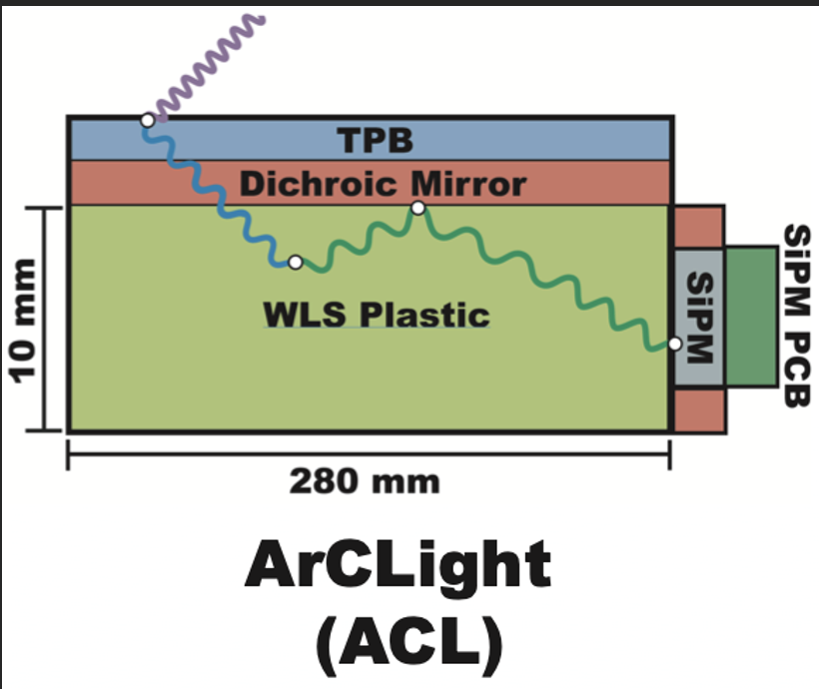
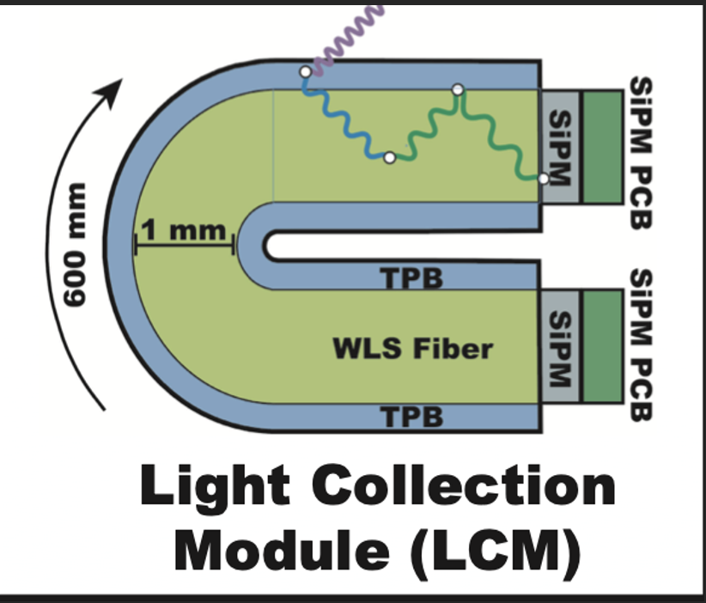
Light readout system
Thin-profile VUV sensitive light-traps perpendicular to the pixelated anode.
96 SiPMs per TPC provide 25% photo-coverage.
Two complementary light traps with shared readout electronics:
ArCLight (ArgonCube light detector)
30 cm x 50 cm x 1 cm
6 SiPM channels
LCM (light collection module)
10 cm x 50 cm x 1 cm
2 SiPM channels
Zoya Vallari, NNN 2024
Notes:
How are these different from XARAPUCA light traps?

Slide 30
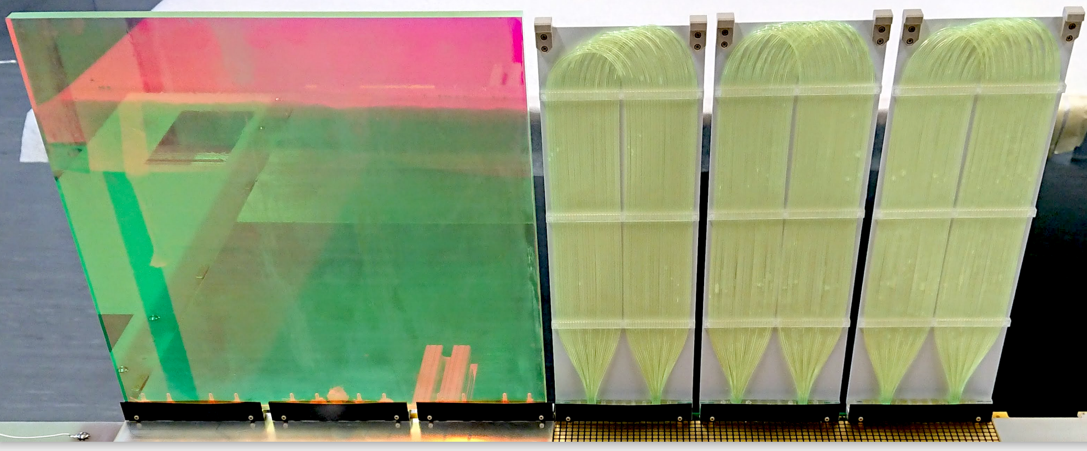
Light readout system
 | ArCLight | LCM
Photon Detection Efficiency | ~0.2% | ~0.6%
Spatial resolution | ~5cm | ~10cm
Strengths | High dynamic range | ~2 ns time resolution @200 PE
Zoya Vallari, NNN 2024
Notes:
How are these different from XARAPUCA light traps? The LCM shows an average efficiency of 0.6%, which enables a light trigger for events depositing MeV-scale energies, with an accurate scintillation amplitude and energy reconstruction.

Slide 31
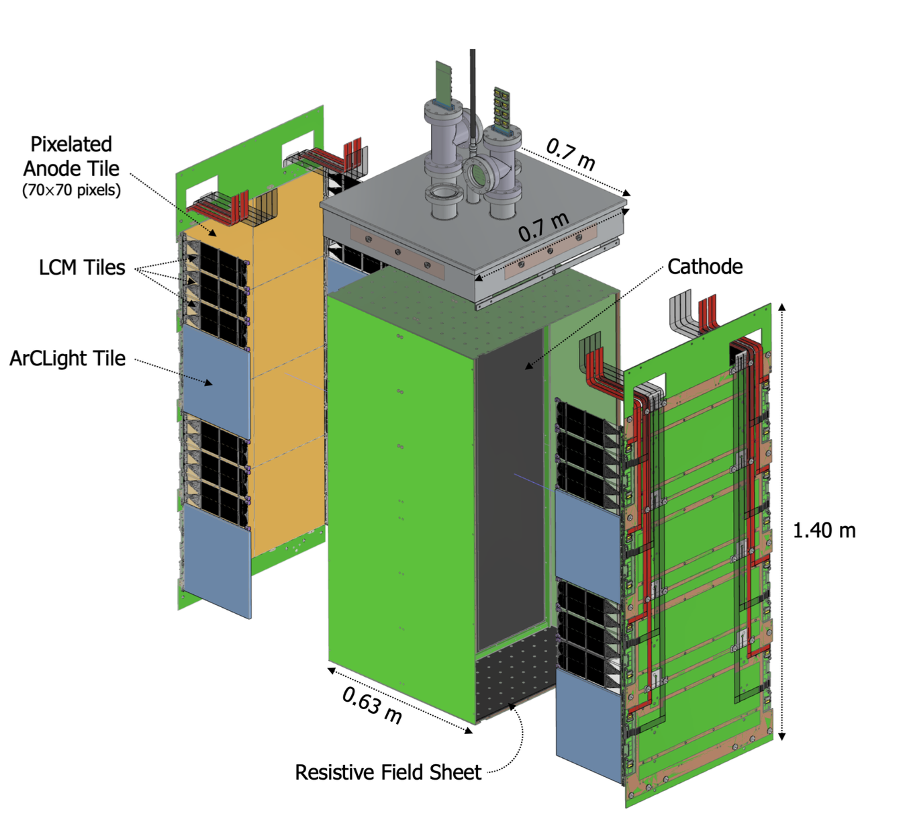
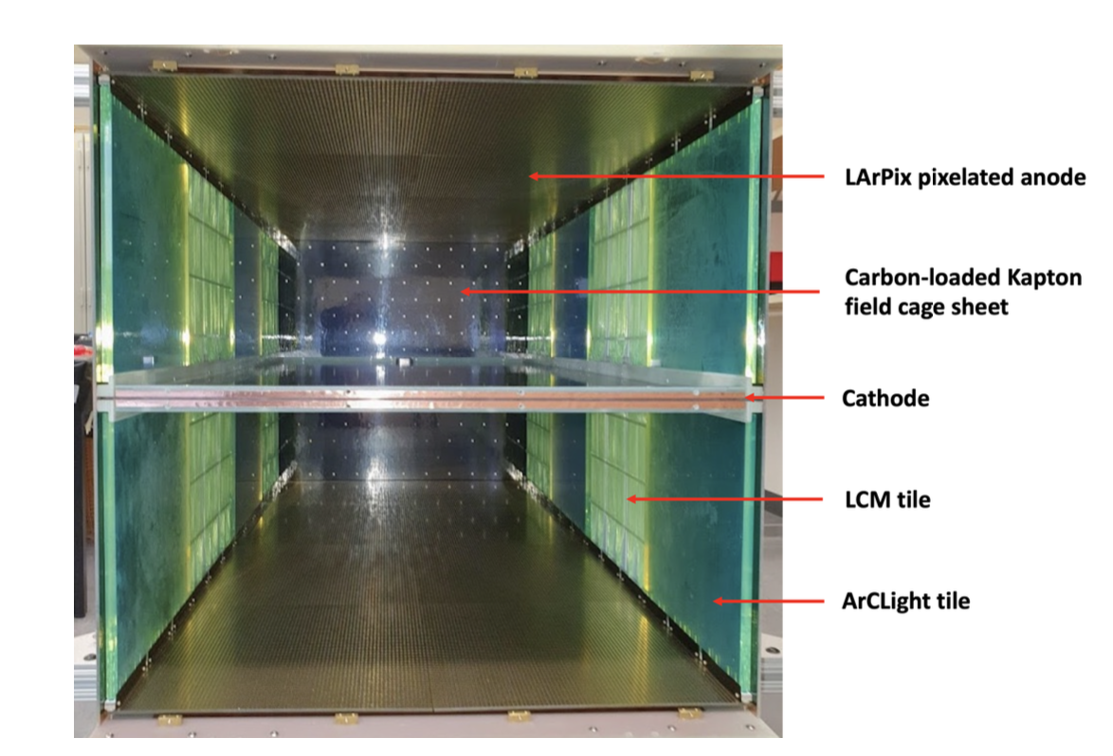
Putting it all together: A Modular LArTPC
Zoya Vallari, NNN 2024

Slide 32
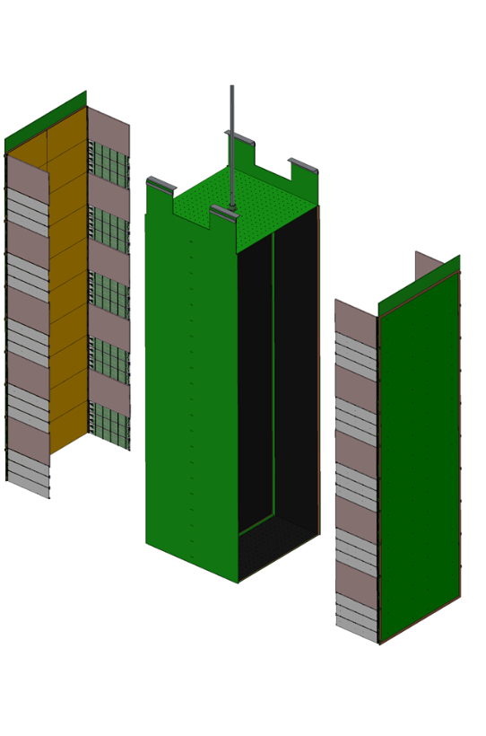
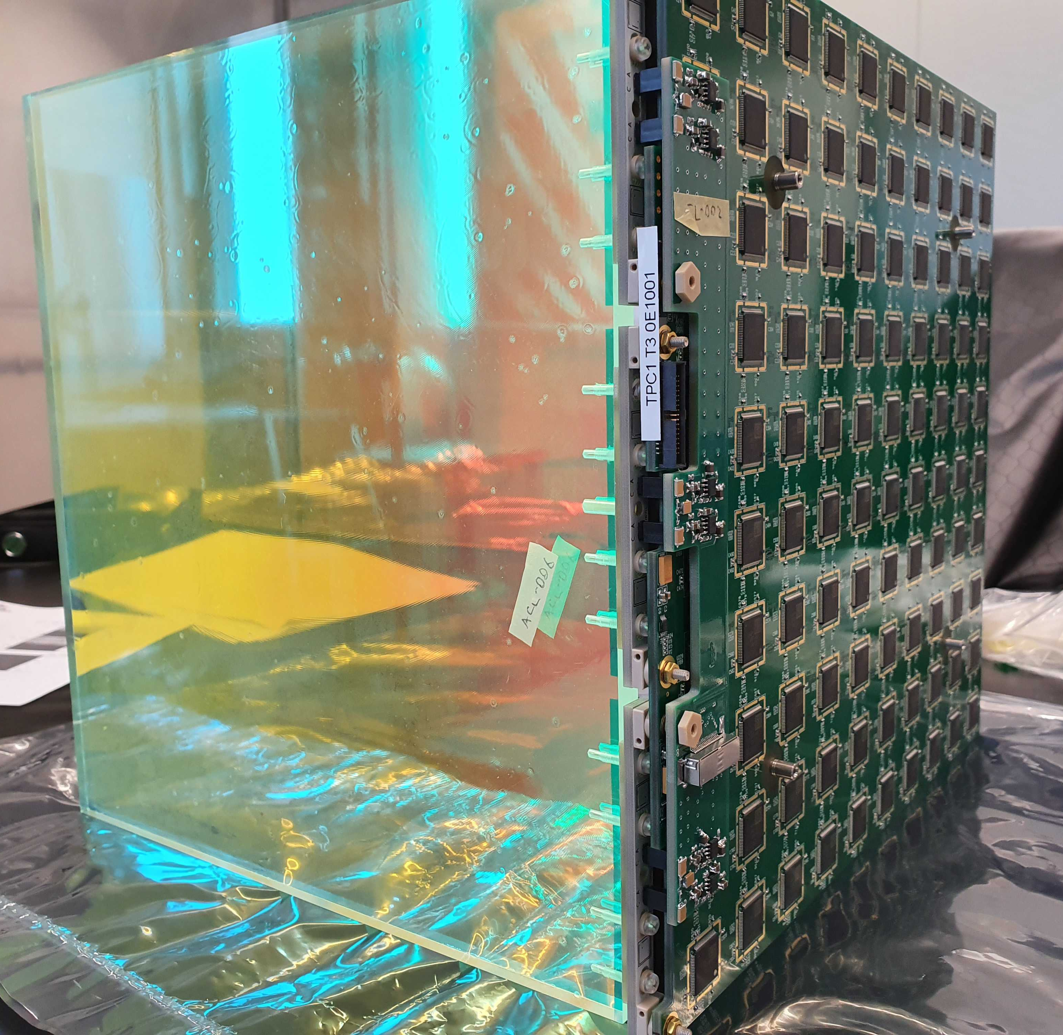
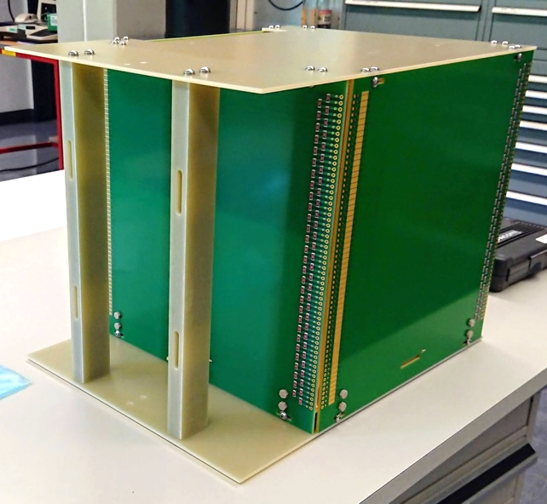
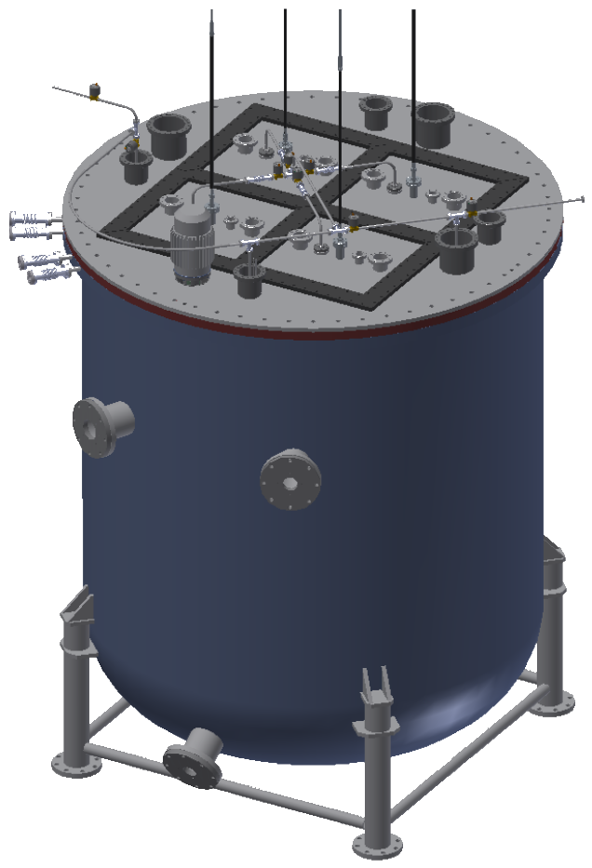
Technical Demos
2018–2020
Demonstration of individual novel technologies
2020
Single cube prototypes: First combined test of charge readout and light readout systems
2021–2023
Single module demonstrators: Ton-scale, fully-integrated prototype of ND-LAr module measuring cosmic rays.
2024
2x2 demonstrator: Designed with four single modules in the neutrino beam at Fermilab.
2x2 Cryostat
Single LAr Cube
x 4

Slide 33
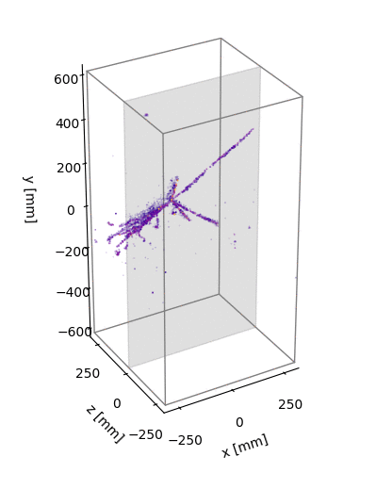
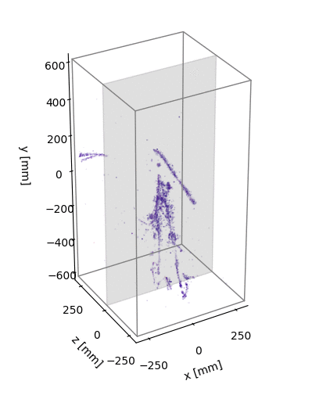
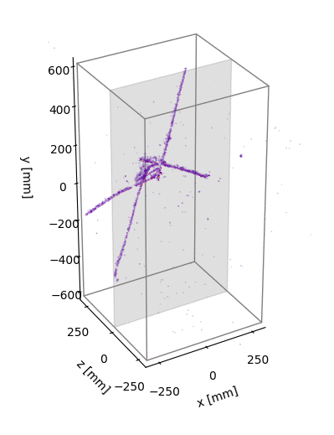
Single Module Demonstrators
Collected O(100)M cosmic ray events with successful operation of four ton-scale LArTPC modules
Notes:
four fully-integrated ton-scale O(100k) pixel channel systems
Collected >100 M cosmic-ray events

Slide 34
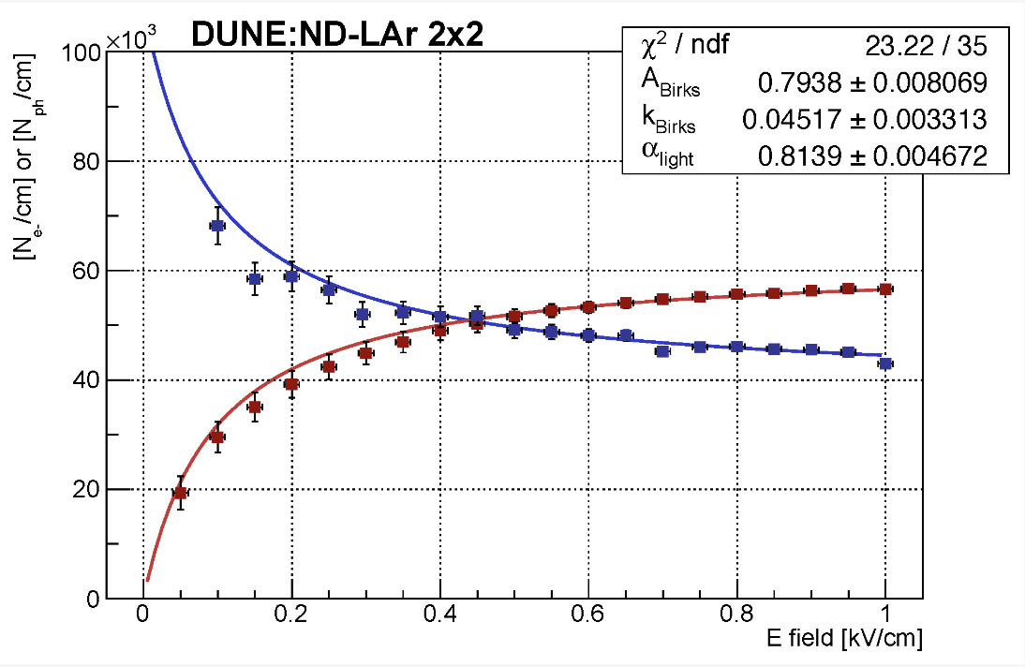
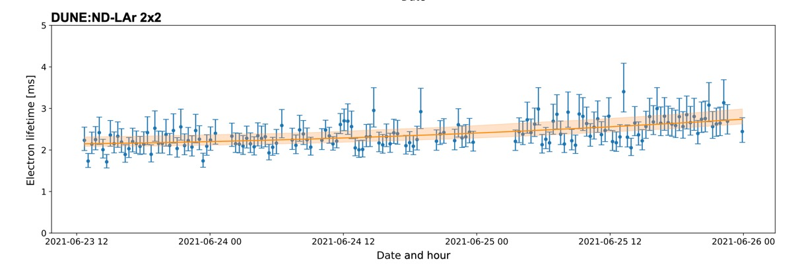
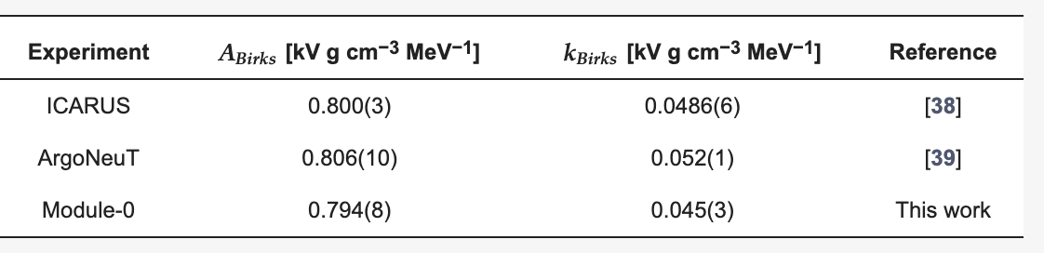
Single module operations
A. Abed Abud et al Instruments 2024, 8(3), 41
Performance of a modular Ton-scale
Pixel-Readout Liquid Argon
Time Projection Chamber
Operations met all requirements for DUNE ND-LAr design:
Stable HV at ~30kV (~1 kV/cm drift, 2x target)
Stable Purity at >2ms (>4x target)
MIP Charge Signal-to-Noise >20:1 (at target)
No component failures during operation
With high statistics data, modular LArTPC program is already producing competitive measurements.
Notes:
~950 e ENC(ENC: equivalent noise charge)

Slide 35
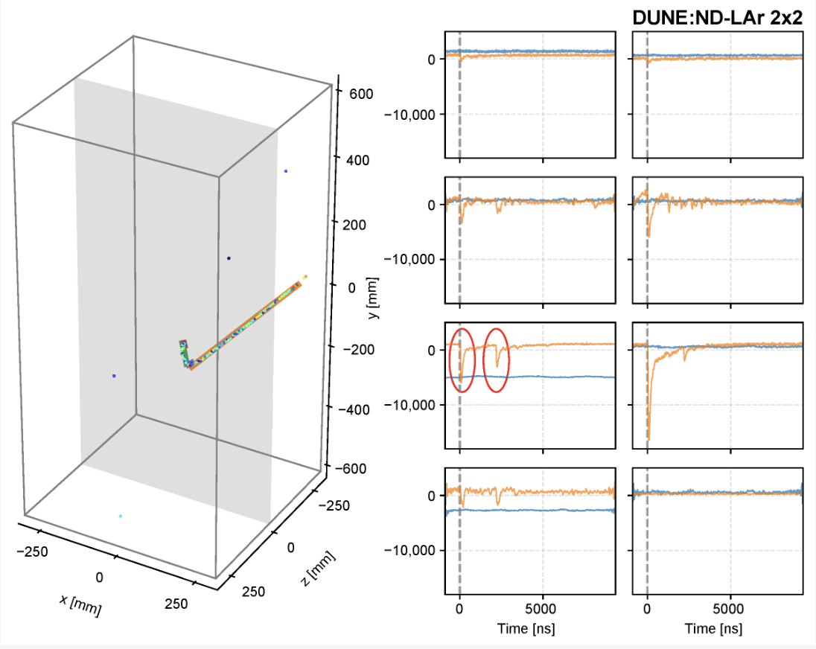
charge-light matching
A. Abed Abud et al Instruments 2024, 8(3), 41
Michel electrons from the stopping muon are an important standard candle.
~2 μs muon lifetime is shorter than the drift speed leading to negligible position displacement but a clear signature in the timing signal given the ns-scale resolution.
Zoya Vallari, NNN 2024
Notes:
a long muon track ending with a Bragg peak followed by a short ionization track from the electron at a different angle with respect to the muon direction.

Slide 36

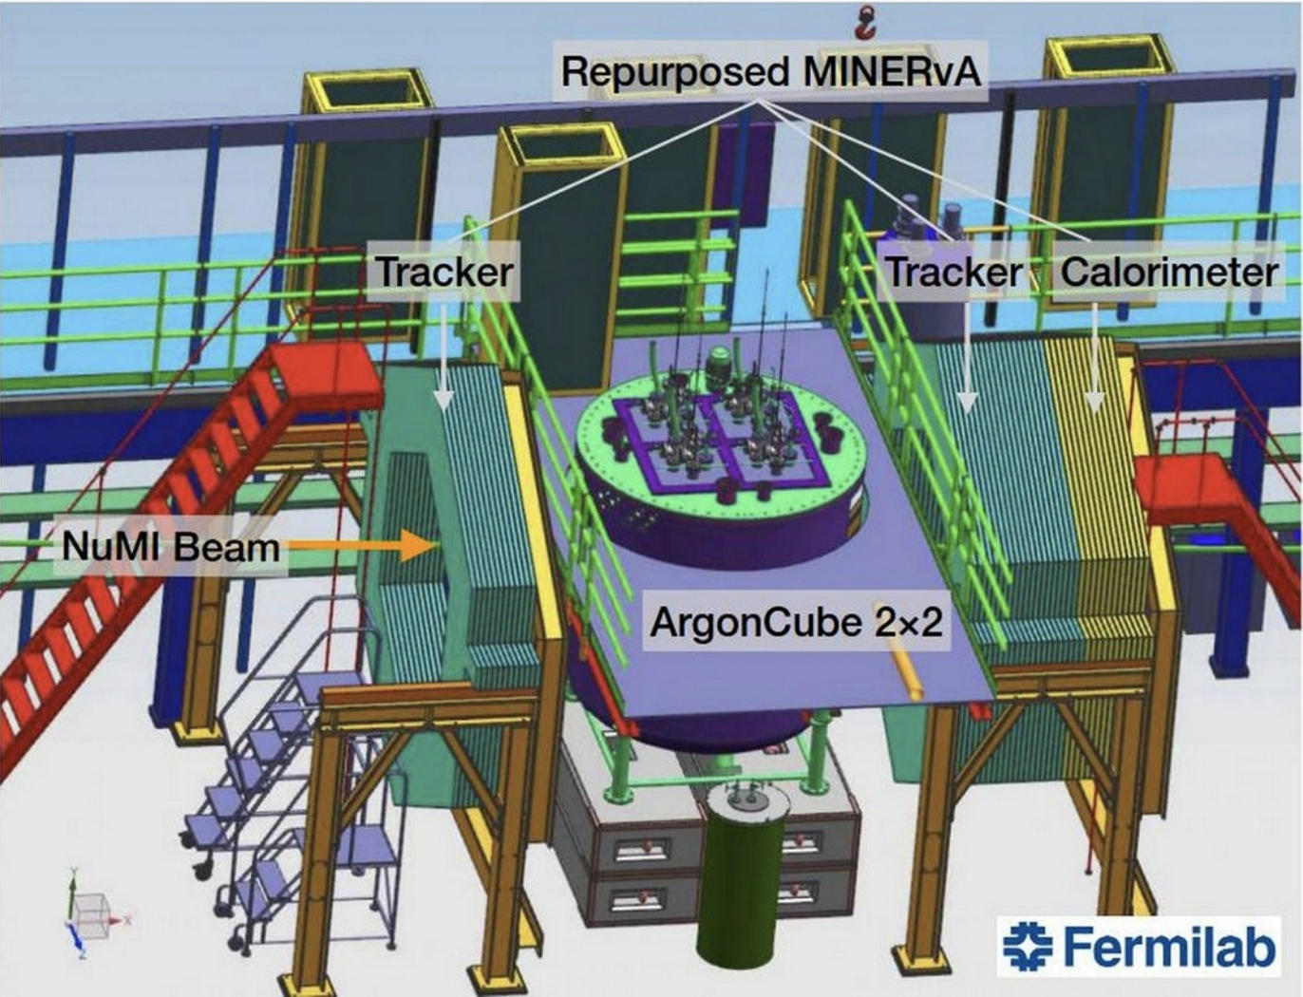
2x2 Demonstrator
First DUNE (prototype) detector
to take neutrino beam data!
4 LArTPC modules assembled as a prototype detector with repurposed scintillator planes from Minerva providing tracking.
LArTPC Modules

Slide 37
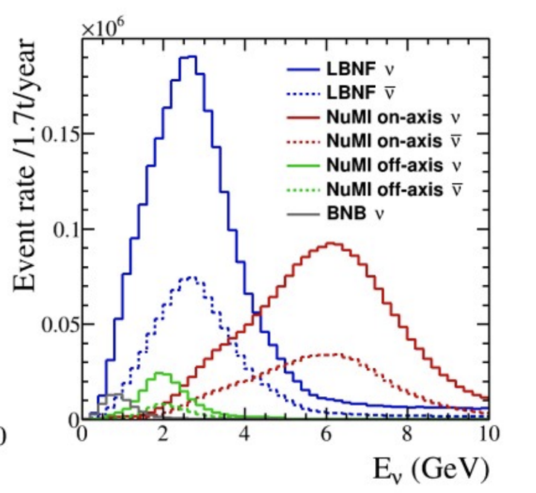
2x2 Demonstrator
First DUNE (prototype) detector
to take neutrino beam data!
4 LArTPC modules assembled as a prototype detector with repurposed scintillator planes from Minerva providing tracking.
A run in the NuMI beam provides comparable intensity to the LBNF beam.
Plot Credit: Callum Wilkinson

Slide 38
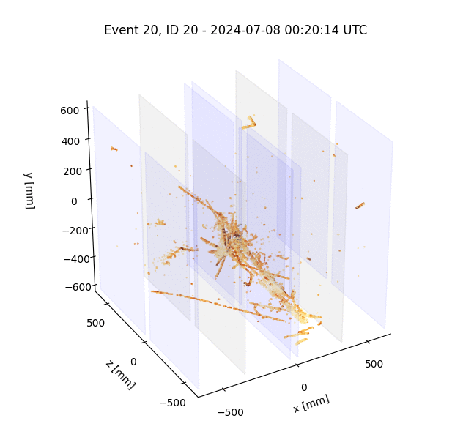
2x2 Demonstrator
First DUNE (prototype) detector
to take neutrino beam data!
4 LArTPC modules assembled as a prototype detector with repurposed scintillator planes from Minerva providing tracking.
A run in the NuMI beam provides comparable intensity to the LBNF beam.
2x2 collected few days of high purity neutrino beam data in July 2024.

Slide 39

Zoya Vallari, NNN 2024

Slide 40
summary
Zoya Vallari, NNN 2024

Slide 41


DUNE ND-LAr next generation TPC
5 x 7 array of LAr TPC modules (1 m x 1m x 3m) with ~67t Fiducial Volume
To cope with the extremely high-multiplicity environment of the most powerful accelerator neutrino beam, DUNE ND-LAr employs multiple advanced technologies for next-generation LArTPCs:
~14M pixels across a 5 x 7 array of TPC modules
Central cathode
Two anode planes of PCB tiles with gold-plated pixel pads and LArPix ASICs on opposite sides
Optically segmented modular design with 50 cm drift
Resistive shell field cage with light detection modules on the side

Slide 42

We are excited to embrace the challenge of “too-many-neutrinos” in the precision era of neutrino physics.
We aim to capture every neutrino interaction—pixel by pixel!!
Image by R. Soleti
Zoya Vallari, NNN 2024

Slide 43
SUPPLEMENTARY SLIDES
Zoya Vallari, NNN 2024

Slide 44

DUNE ND Complex
Downstream Magnetized Tracker
(such as TMS)
To achieve its ambitious physics goals, DUNE will need to constrain its systematics to a few percent level.
A suite of near detectors are designed to robustly constrain systematics and achieve required sensitivities.
Muon-range
spectrometer
Beam
axis
PRISM
System for moving the LArTPC and tracker up to 30m transverse to the beam
System for On-Axis Neutrino Detection

Slide 45






Dune nd requirements
Measurements transferable to the FD
Constrain the cross-section model
Measure the neutrino flux
Obtain measurement with different fluxes
Monitor time variations of the neutrino beam
Operate in high-rate environment
New exciting physics measurements to test BSM, sterile and dark-matter models.
ND-LAr
TMS
SAND

Slide 46


LArPix specifications
Specification | Value | Comment
Analog inputs | 64 | Single-ended input
Gain | 4.5 $μ$V/e⁻
Power | <200 $μ$W/channel | Static power dissipation
Dynamic range | 1.3 V | Chip configurable
ADC resolution | 8 bits
ADC LSB | 4 mV | Chip configurable
Threshold range | 0 to 1.8 V | Channel configurable
Threshold resolution | 1.5 mV
Channel linearity | < 1.2% | Pre-calibration
Multi-hit separation time | 1.2 $μ$s | Chip configurable
Operating temperature | 80 to 300 K
Specification | Value | Comment
Heat density | ~13 mW/ASIC
Pixel multiplexing | 6.4k channels/cable
Noise | ~850 e⁻ ENC
Tile leakage current | < 5 e⁻ / 500 $μ$s
Charge resolution | < 1200 e⁻ | < 5% MIP charge
Spatial resolution | 1.1 to 1.3 mm | Geometry dependent
Timing resolution | 0.7 $μ$s | Chip configurable
Saturation level | > 200 ke⁻
Triggering efficiency | ~80% for MIP
MIP S:N | >20:1

Slide 47



2x2 MINOS Hall Underground Installation @Fermilab

