Slide 1

Overview of Neutrino Oscillations
David Vanegas Forero (D. V. Forero)
dvanegas@udemedellin.edu.co
NNN24, 29th October

Slide 2
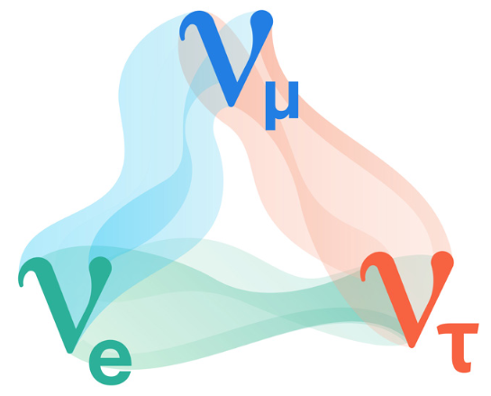
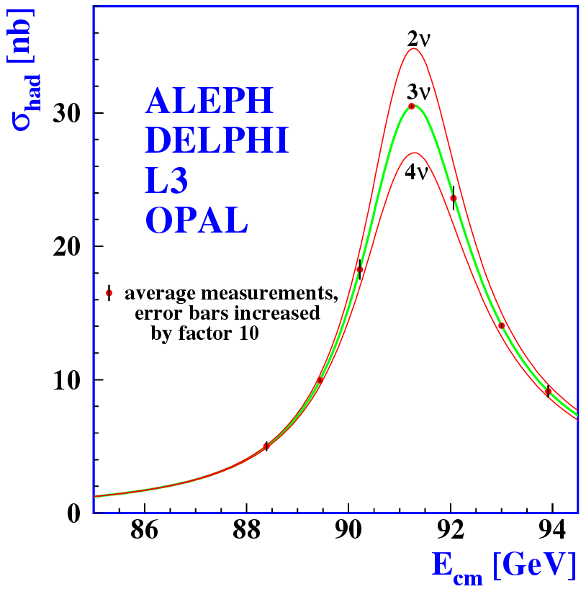
¿What do we know about the neutrino?
It is a fundamental particle, a fermion
Has no electric charge
Interacts mainly through the weak interaction
Comes in three flavors, associated to each charged lepton (e, μ, τ)
  Starting point, 3-active neutrinos
Changes its flavor during propagation
  Explained by neutrino oscillations
    In turn imply non-zero neutrino masses
      DIRECT evicence of BSM physics

Slide 3
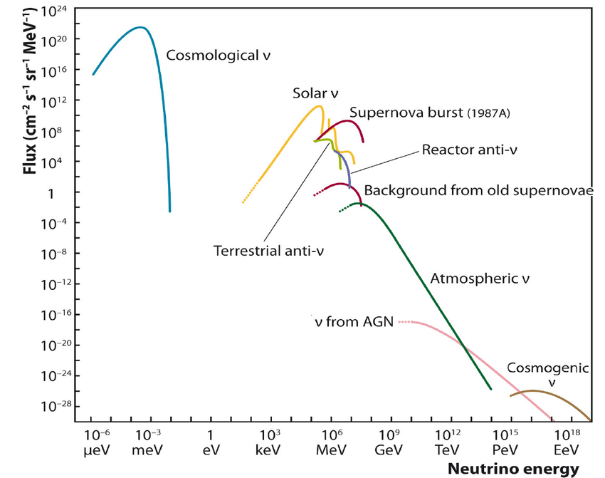
Neutrino Sources
Oscillation Energy Window :
~1 MeV -- ~100 GeVs
Oscillation
Window
Solar
Atmospheric
Accelerator
Reactor

Slide 4
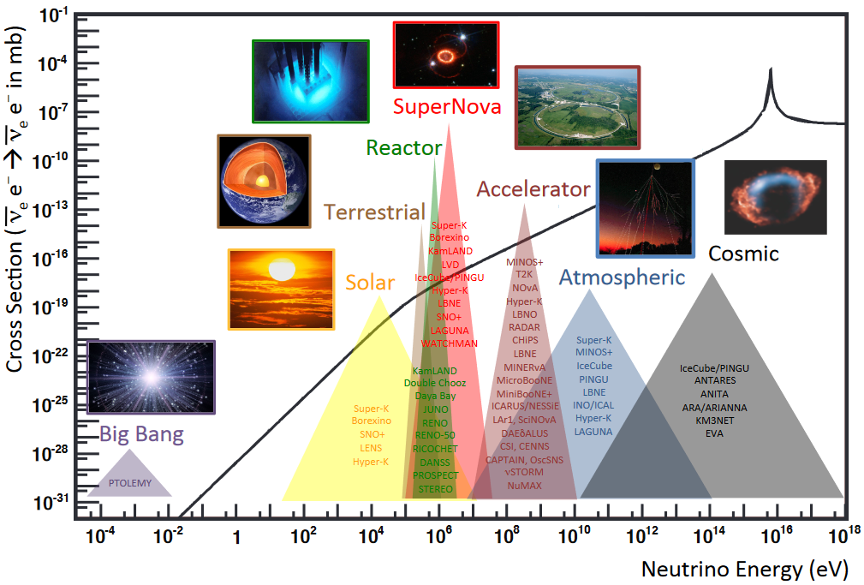

Neutrino Interactions
Oscillation
Window
1b = ${10}^{−28}m^{2}$
Solar
Geoneutrinos
Reactor
SuperNova
Accelerator
Atmospheric
Notes:
Neutrino Energy is a key variable

Slide 5
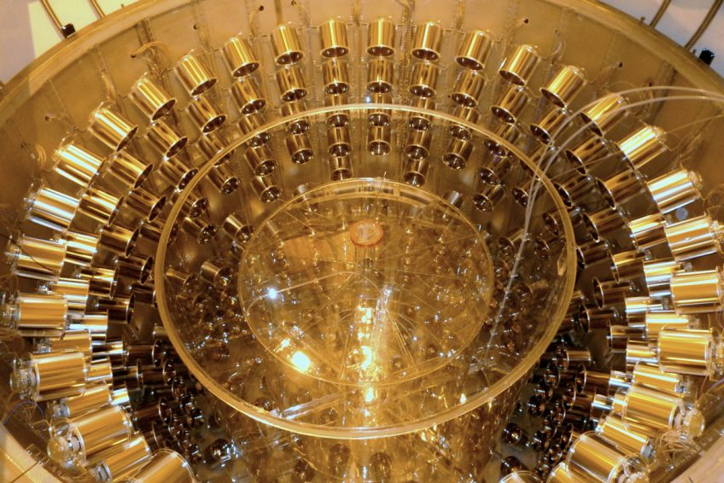
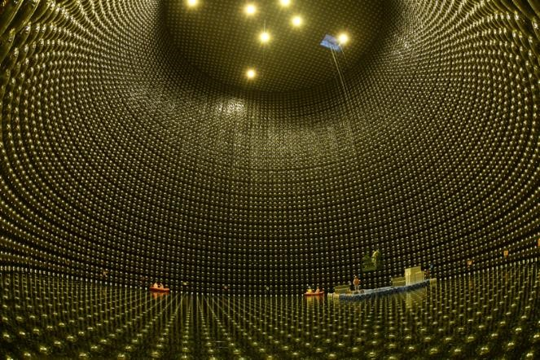
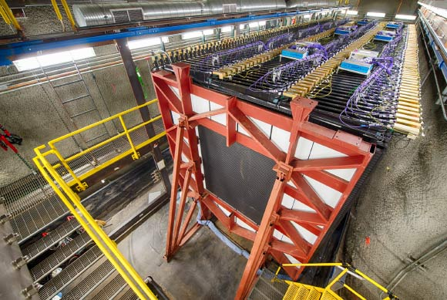
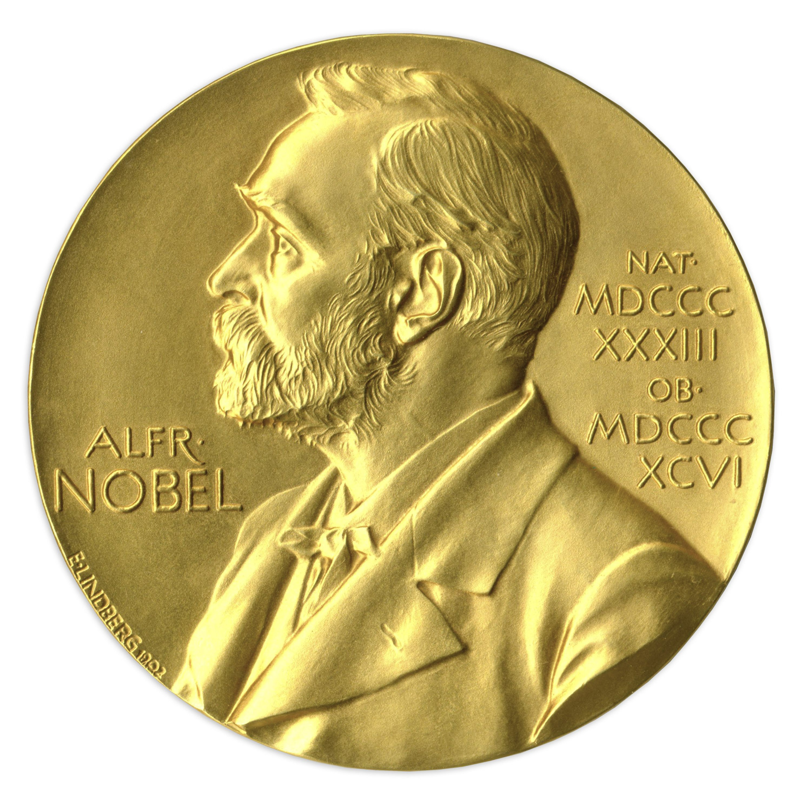


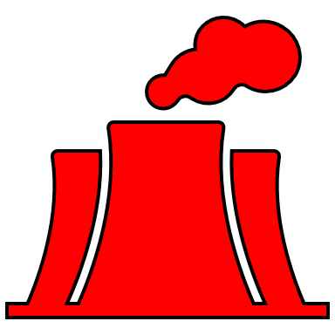


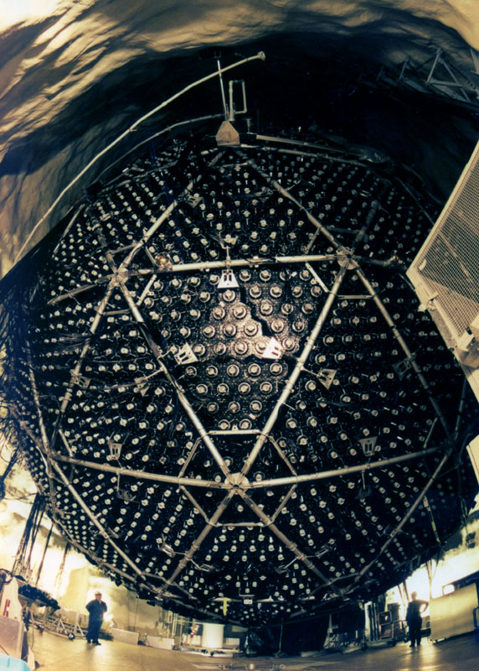
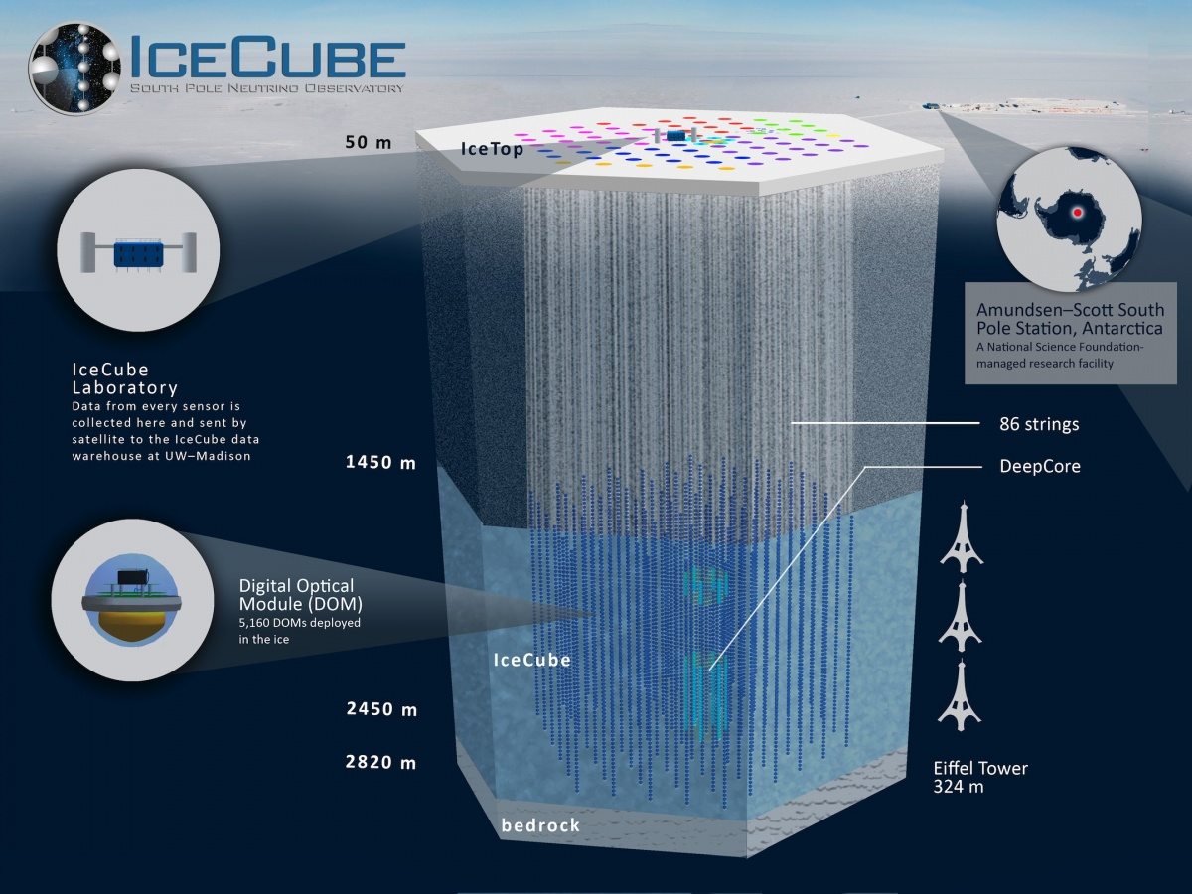
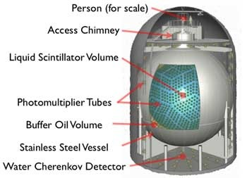
DubleChooz (&DYB & RENO)
SuperKamiokande (& T2K)
NOvA
SNO
Neutrino Detectors
KamLAND
KamLAND
Notes:
Where do neutrinos (from different sources) are detected? Each one with different detector techniques

Slide 6
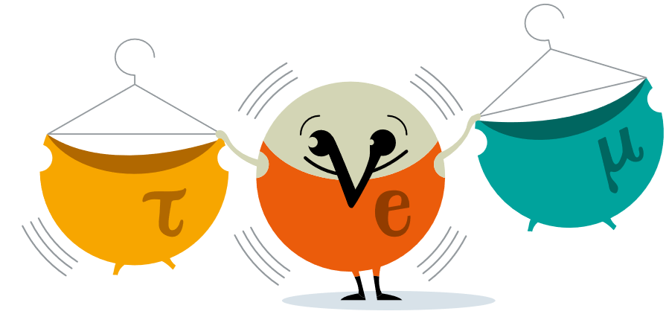
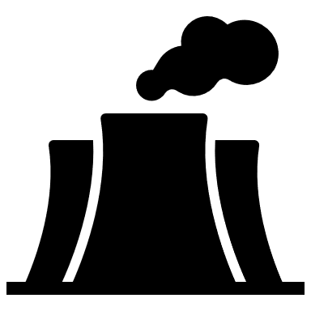
Neutrino oscillation experiment, the concept
An intense neutrino source
Massive FD
Optimized Baseline
ND
Help reduce flux systematics
Run for several yrs, gather “enough” stats
Notes:
Neutrino Experiment=Source+Detector, separated the CORRECT baseline

Slide 7
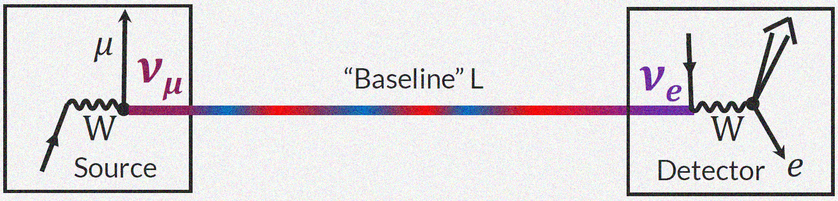
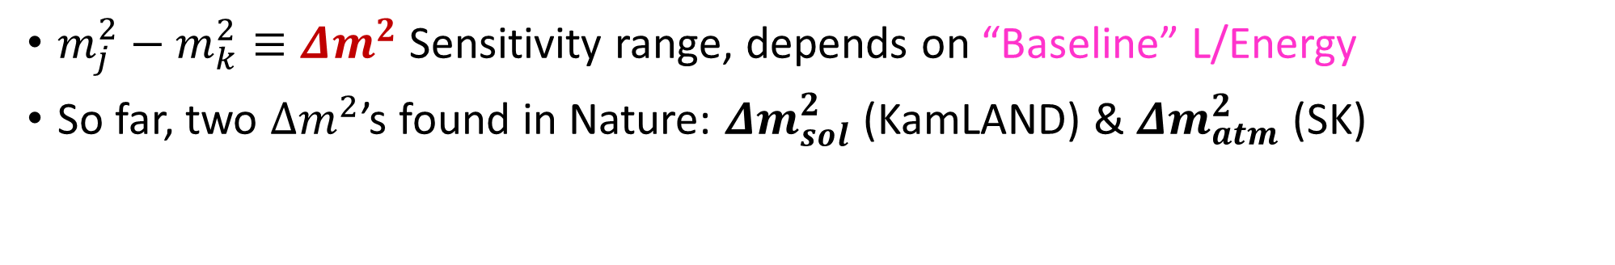
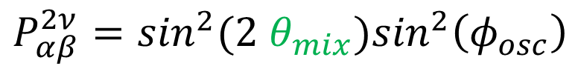
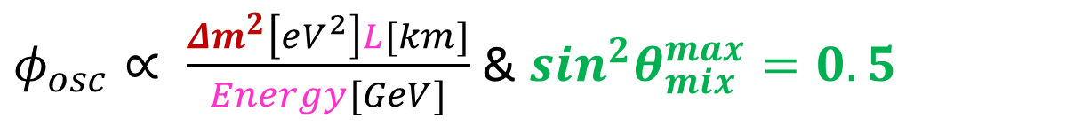
Neutrino oscillations ‘in a Nutshell’
CC interaction
CC interaction
$φ_{osc}∝ \frac{{Δm}^{2}\left[eV^{2}\right]L[km]}{Energy[GeV]}$ & $\sin^{2}θ_{mix}^{max}=0.5$
$$P_{αβ}^{2ν}=\sin^{2}{(2 θ}_{mix})\sin^{2}\left(φ_{osc}\right)$$
$m_{j}^{2}−m_{k}^{2}≡Δm^{2}$ Sensitivity range, depends on “Baseline” L/Energy
So far, two $Δm^{2}$’s found in Nature: ${Δm}_{sol}^{2}$ (KamLAND) & ${Δm}_{atm}^{2}$ (SK)
Non-zero neutrino masses, a discovery recognized -> Physics Nobel Prize (2015)
Notes:
Neutrino Experiment=Source+Detector, separated theCORRECT baseline

Slide 8
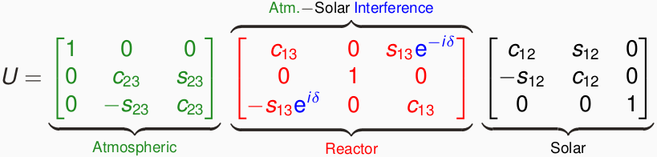
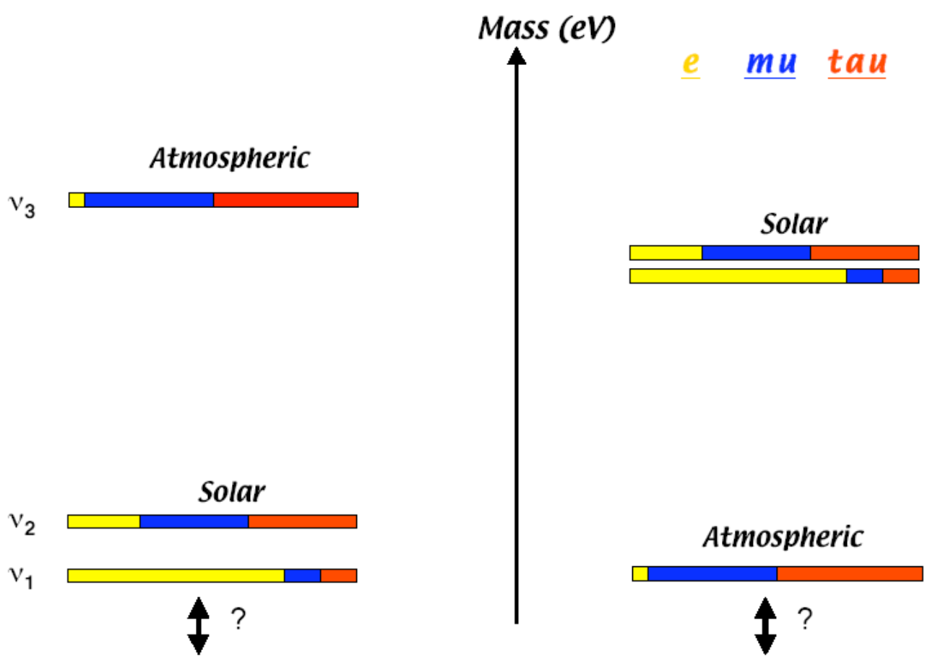
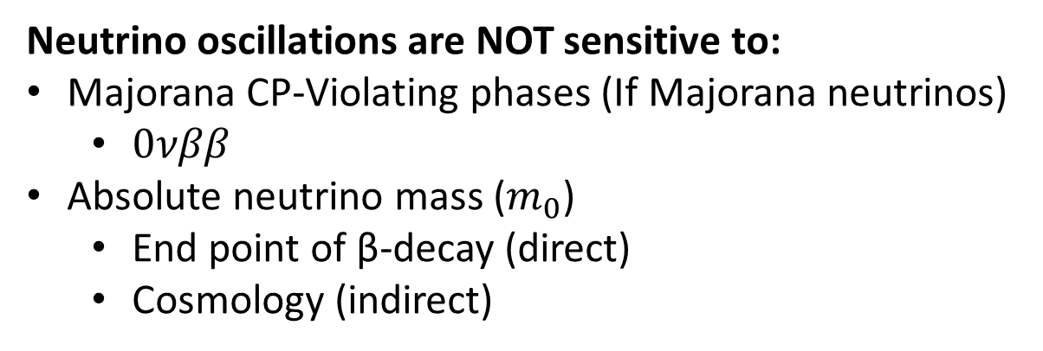
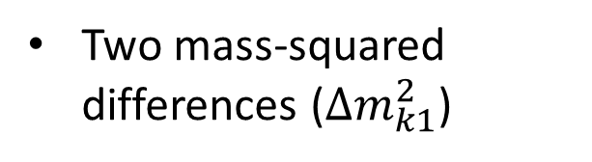

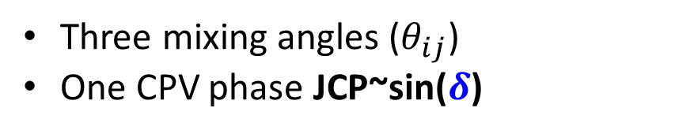

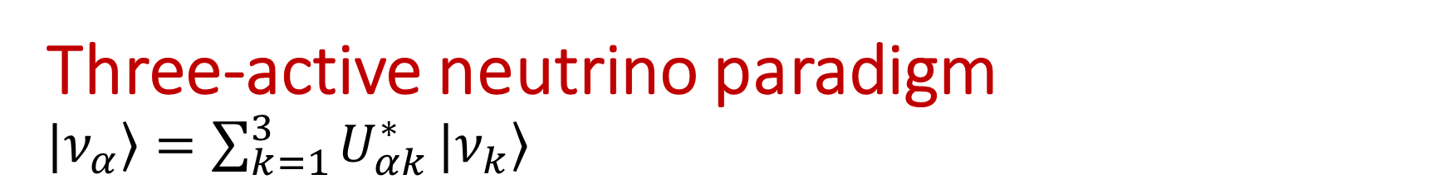
Three-active neutrino paradigm $\left.|ν_{α}\right\rangle =\sum_{k=1}^{3}{U_{αk}^{∗}}|\left.ν_{k}\right\rangle$
Not unique param.
  Two possible mass orderings
  Normal (L), Inverted (R)
Three mixing angles ($θ_{ij}$)
One CPV phase JCP~sin($δ$)
Two mass-squared differences (${Δm}_{k1}^{2}$)
Neutrino oscillations are NOT sensitive to:
Majorana CP-Violating phases (If Majorana neutrinos)
  $0νββ$
Absolute neutrino mass ($m_{0}$)
  End point of β-decay (direct)
  Cosmology (indirect)
Complementarity with other searches
Dedicated talks today
${Δm}_{31}^{2}$>0
${Δm}_{31}^{2}<$0

Slide 9

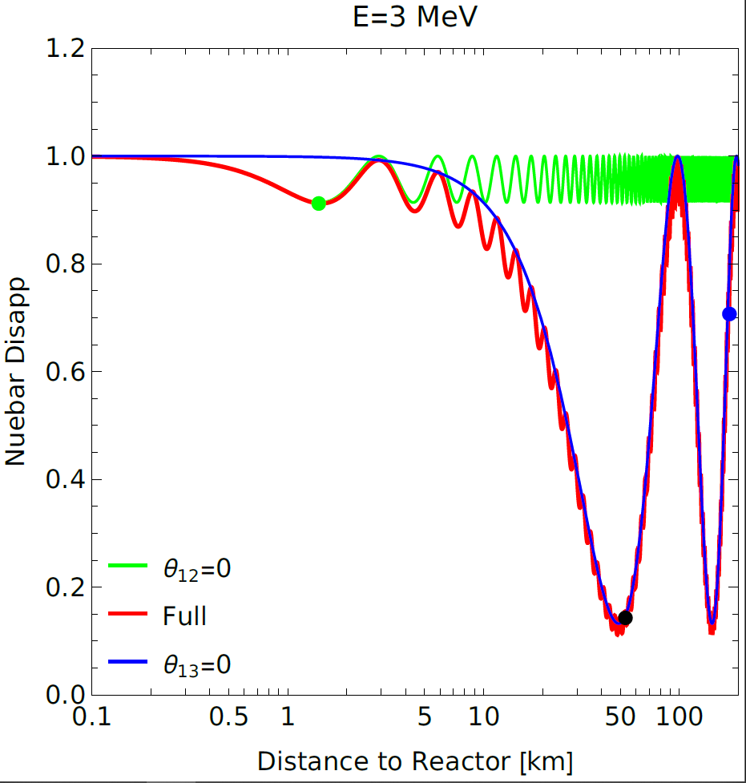
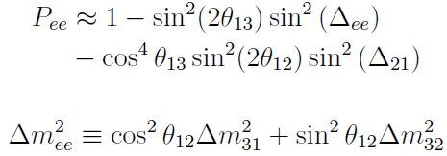

Nue(nuebar) disappearance in vacuum
KamLAND
No dependence on
  $θ_{23}$ neither on $δ$
For atm osc. Dominance (neglecting solar osc. term), it can be written as
DYB
JUNO
Nunokawa, Parke & Zukanovich Funchal (2005)

Slide 10
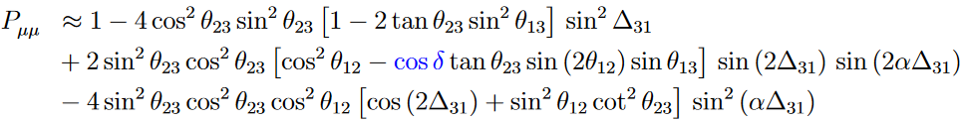
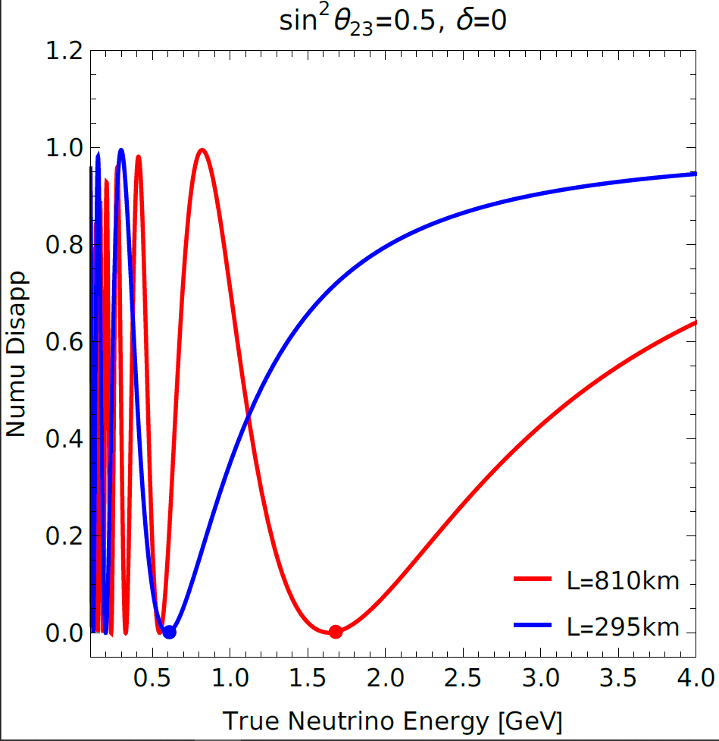
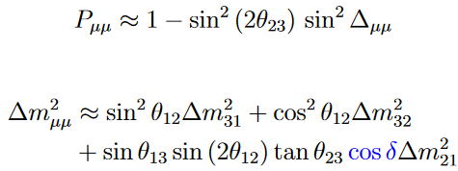

Numu(numubar) disappearance in vacuum
Dependence on all osc. Parameters, but $δ$ effect suppressed off-peak osc. phase
For atm osc. dominance, it can be written
Inherent $θ_{23}$ octant degeneracy
Same expression for numubar osc.
Nunokawa, Parke & Zukanovich Funchal (2005)

Slide 11
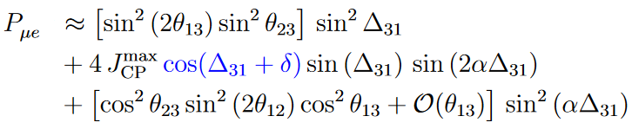
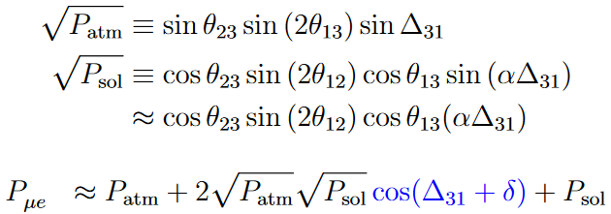
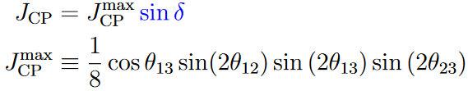
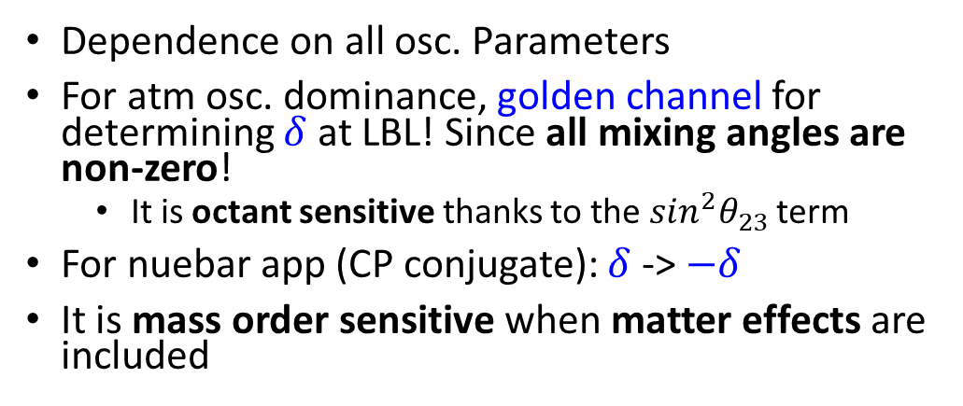
Nue appearance in vacuum
For atm osc. Dominance:
Nunokawa, Parke & Valle (2007)
Dependence on all osc. Parameters
For atm osc. dominance, golden channel for determining $δ$ at LBL! Since all mixing angles are non-zero!
  It is octant sensitive thanks to the $\sin^{2}θ_{23}$ term
For nuebar app (CP conjugate): $δ$-> $−δ$
It is mass order sensitive when matter effects are included
The CP-term appears as an interference between the atmospheric and solar oscillations
CP-term is a pure 3-flavor effect
Neutrino oscillations are coupled

Slide 12
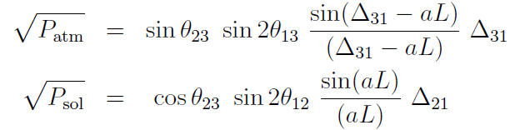

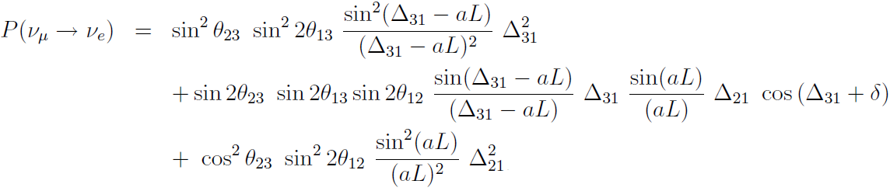
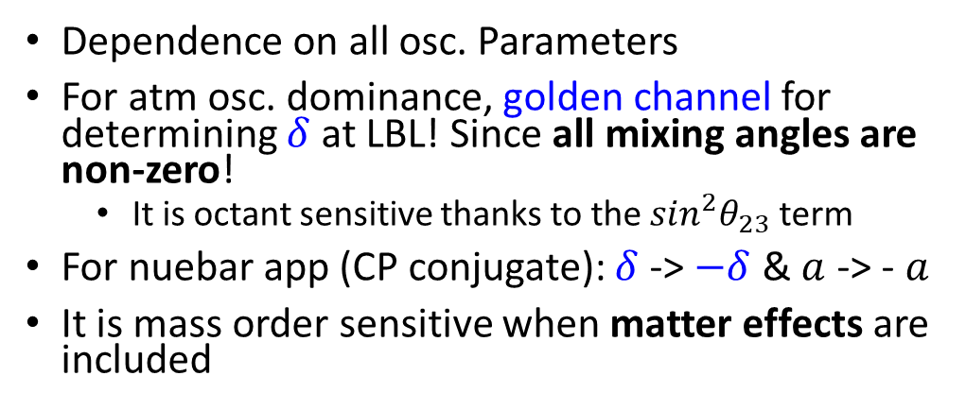
Nue appearance in (constant) matter
From vacuum expression,
Dependence on all osc. Parameters
For atm osc. dominance, golden channel for determining $δ$ at LBL! Since all mixing angles are non-zero!
  It is octant sensitive thanks to the $\sin^{2}θ_{23}$ term
For nuebar app (CP conjugate): $δ$-> $−δ$ & $a$ -> - $a$
It is mass order sensitive when matter effects are included
Nunokawa, Parke & Valle (2007)
Cervera et. al (2000)
Freund (2001)
Akhmedov et. Al (2004)

Slide 13
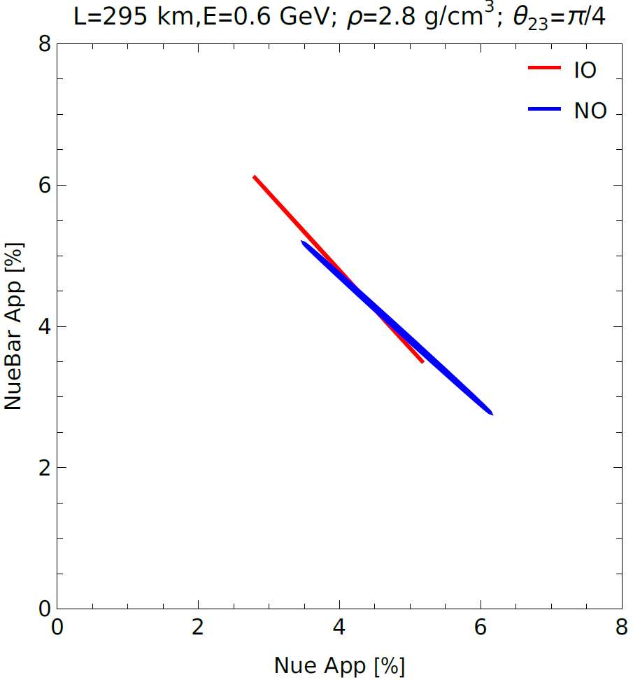
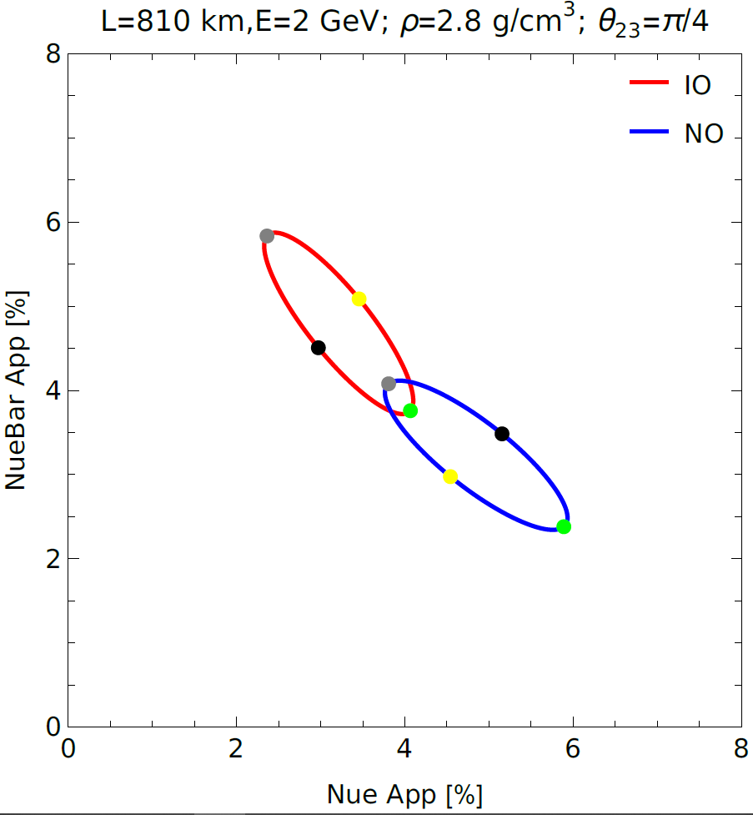

Nue appearance in (constant) matter
Bi-probability plots (fixed Etrue)
Minakata & Nunokawa (2001) hep-ph/0108085
← Matter effect →
CP conserving
$$0 , π$$
CP violating
$$−\frac{π}{2} , \frac{π}{2}$$

Slide 14
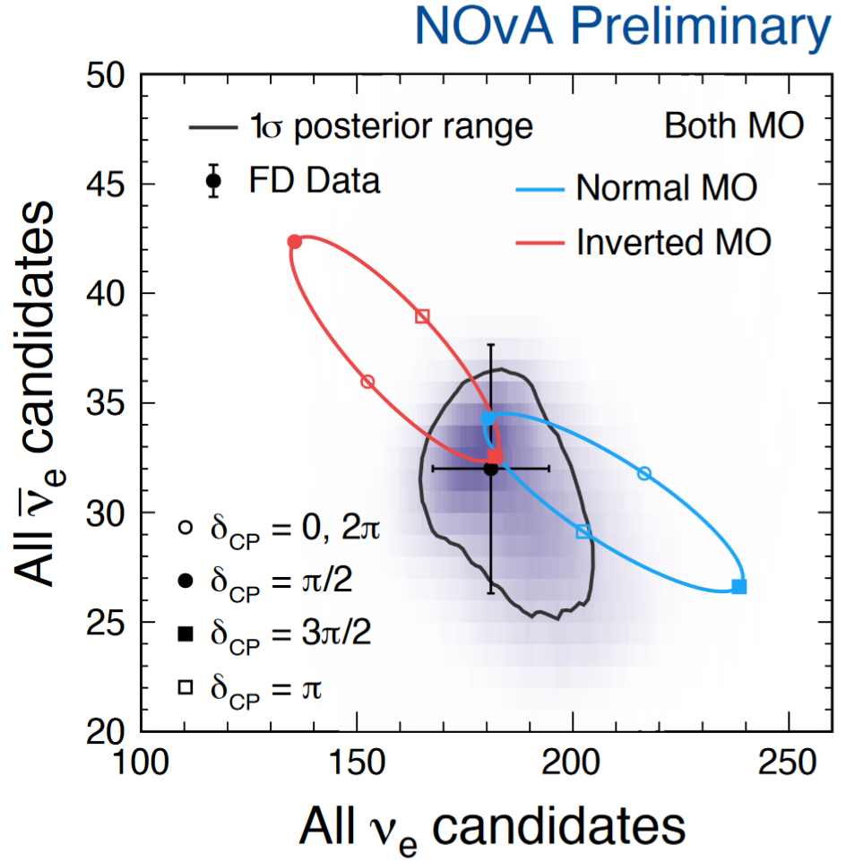
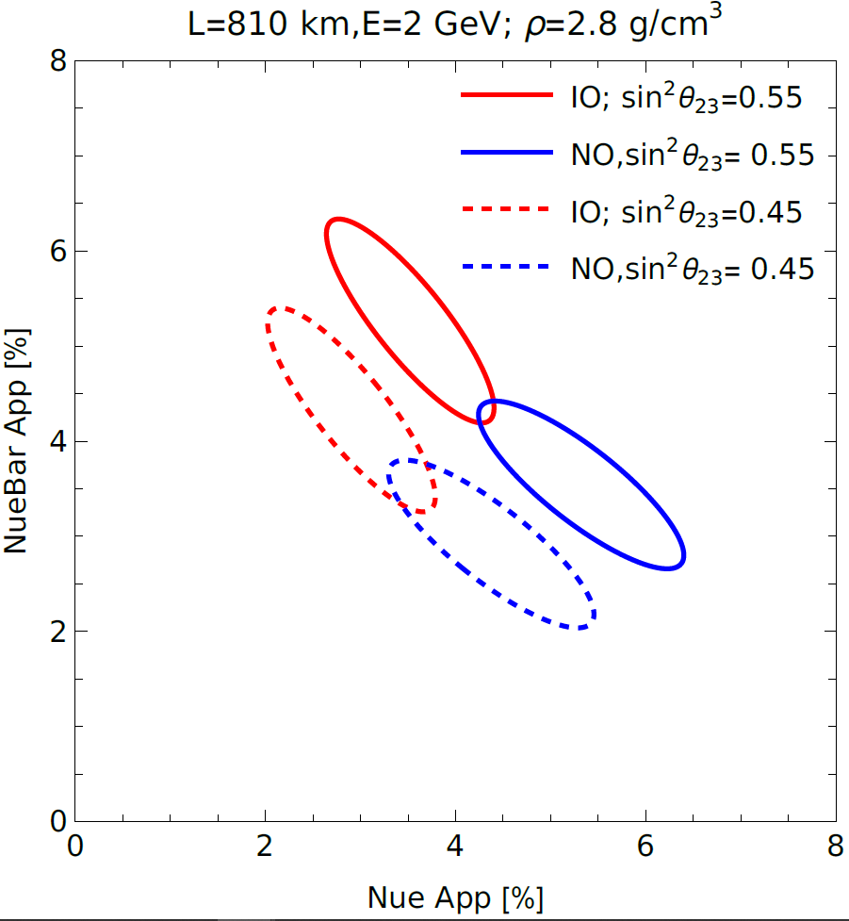
Nue appearance in (constant) matter
Bi-probability plots (fixed Etrue)
Zoya yesterday
Lower Octant
Upper Octant

Slide 15
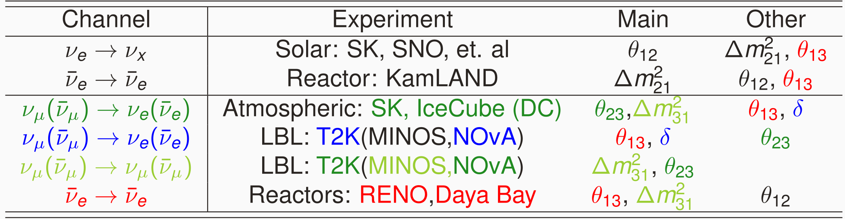

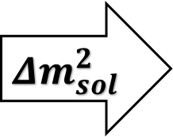
Neutrino Oscillation Channels, parameter dependency
Two $Δm^{2}$’s found in Nature: $Δm_{21}^{2}={Δm}_{sol}^{2}$ & $|Δm_{31}^{2}|∝{Δm}_{atm}^{2}$
$${Δm}_{sol}^{2}$$
$${Δm}_{atm}^{2}$$
No single experiment is sensitive to ALL parameters, so we need global-fits:
To find the parameters allowed by MOST of osc. nu data
  Might reveal tensions between different sectors
To properly account for correlations between parameters
Enhance sensitivity to subleading osc. Effects (CP, Mass Ordering)
Notes:
Neutrino sectors (Data sets) considered in the Global-fit

Slide 16




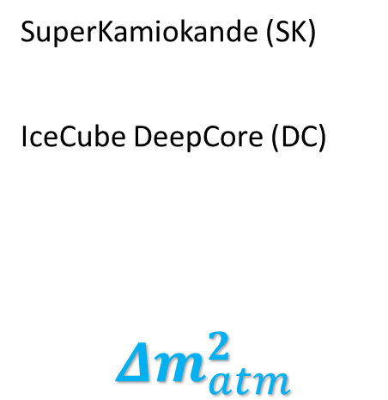
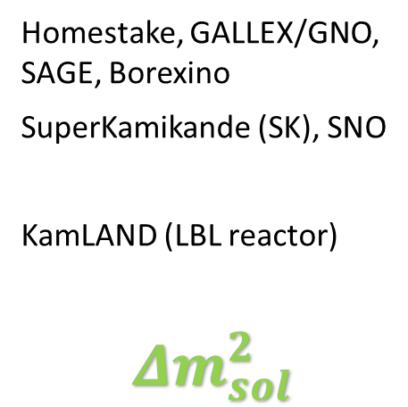
Neutrino Osc. Experiments (by their source)
Neutrino Experiment=Source+Detector, separated the CORRECT baseline
Solar
Atmospheric
Accelerator (LBL)
Reactor (km)
Homestake, GALLEX/GNO, SAGE, Borexino
SuperKamikande (SK), SNO
KamLAND (LBL reactor)
$${Δm}_{sol}^{2}$$
SuperKamiokande (SK)
IceCube DeepCore (DC)
$${Δm}_{atm}^{2}$$
K2K, MINOS
T2K, NOvA
Daya Bay
RENO
Tunable source or that can be characterized
Multiple detectors (ND, FD)
Notes:
Neutrino sectors (Data sets) considered in the Global-fit

Slide 17
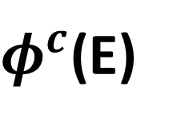




Neutrino events, its calculation per experiment, per osc. channel (C)
An intense neutrino source
Massive FD
$$σ^{c}(E)$$
$$ε^{c}(E_{rec})$$
$$R^{c}(E,E_{rec})$$
$$P^{c}(L,E;λ\left(θ_{ij},Δm_{k1}^{2},δ;ρ\right))$$
Optimized Baseline “L”
$φ^{c}$(E)
ND
Dedicated talk on Friday
Hardest part
Inclusion Sys. Uncert. In the analysis
Notes:
Neutrino Experiment=Source+Detector, separated the CORRECT baseline

Slide 18
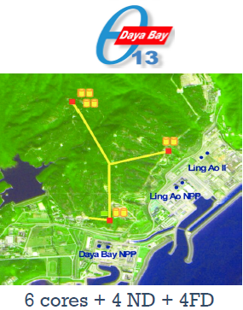





Reactor (multidet.)
1km experiments, nuebar disapp
M. Tórtola @Neutrino2024
Daya Bay: 3158-day data
$$\sin^{2}2θ_{13}=0.0853±0.0024$$
arXiv:2211.14988
RENO: 2900-day data
$$\sin^{2}2θ_{13}=0.0892±0.0063$$
J. Yoo @Neutrino2020
Not longer taking data

Slide 19



LBL & atmospheric
Latest IceCube-DC result, arXiv:2405.02163
M. Tórtola @Neutrino2024
9yrs of data taking (atm nus 3387days)
Track-like events (highest purity numu CC events)
L~O(10-100)km
E~ 5-100 GeV
Not yet included in VLC update@Neutrino2024

Slide 20




Solar sector,
SK Global analysis
Latest SK result, arXiv:2312.12907
External constraint
M. Tórtola @Neutrino2024
Evidence ($\sim 3σ$) for Earth matter effects: D/N Asymmetry (@global ${Δm}_{sol}^{2}$)
Both global analysis coincide “perfectly” bfp

Slide 21








Global-fit results,
$Δχ^{2}$-profiles
~5%
~4%
~3%
3$σ$
$\sim$1$.6σ$
~3%
~1%
?
3$σ$
$$\sim 4.2σ$$
$$2.7σ$$
$$<=>2.7σ$$

Slide 22






Closer look to the CP-violating phase
$$\sim 6.8σ$$
M. Tórtola @Neutrino2024
T2K & NOvA “opposite preference”
Half param space excluded
CP C.
$$\sim 4.1σ$$
CP C.
$$\sim 3.9σ$$
$$\sim 4.2σ$$
$$\sim 2.9σ$$
CP C.

Slide 23





Comparing Global-fit results: BFPs and 3$σ$ ranges
De Salas et. al arXiv:2006.11237 (VLC) Esteban et. al arXiv: 2007.14792 (nu-fit) Capozzi et. al arXiv: 2003.08511 (Bari)
Notes:
All agree with a small preference for 2nd Octant

Slide 24


Comparing Global-fit results: BFPs and 3$σ$ ranges
De Salas et. al arXiv:2006.11237 (VLC) Esteban et. al arXiv: 2007.14792 (nu-fit) Capozzi et. al arXiv: 2003.08511 (Bari)
Notes:
All agree with a preference for 2nd Octant

Slide 25


Global-fit results, lepton mixing
Bfp and $3σ$ Ranges for NO
Could this mixing pattern be a result of some underlying symmetry?
Notes:
Very different mixing pattern in the Quark Sector

Slide 26


Lepton mixing pattern
Before 2012, when reactor mixing angle ($θ_{13}$) was “small” (thought to be zero)
Several possibilities
  Based on non-Abelian Discrete Flavor Symmetries:
    TBM
    BM
    Golden-Ratio
  Texture zeros
After 2012, “large” $θ_{13}≠0$
Some possibilities
  Flavor symmetries plus corrections (for instance from Charged sector) needed
  Modular symmetry (string Compactification): Ex. Gui-Jun Ding talk at Neutrino24 here
Maybe it is just a result of “luck” (Anarchy):
  “random draw from an unbiased distribution of unitary three-by-three matrices”
arXiv:1204.1249

Slide 27


Where we stand so far
1km Reactor, LBL &atmospheric exps. all oscillating at same osc. Frequency due to similar L/E → supporting 3nu flavor paradigm
CP symmetry (δ)
  T2K & NOvA “opposite preference” for NO so global bfp $δ\sim π$ while $δ=\frac{π}{2},$0 disfavored at $>2.9σ$.
  IO: global bfp $δ=3π/2$, while $δ=\frac{π}{2},π$ disfavored at $>3.9σ$.
MO: globally, NO is preferred over IO with $2.7σ$ significance.
Atmospheric mixing ($θ_{23}$): In the 2nd octant for both MO, but 1st Oct and Max. mix. allowed $Δχ^{2}<3$ for NO!
Parameter precision: Ranges from ~1% to ~6%
After previous global-fit results, same questions remain
$J_{CP}∝\sin{δ≠0}$? (violation of the CP-Symmetry in leptonic s.)
NO or IO? (MO)
$\sin^{2}θ_{23}\left(<,=,>\right)0.5$? (Octant)
+ need measuring tau neutrinos for unitarity of the LMM
Precise measurements are needed -> FUTURE NEUTRINO EXPS.

Slide 28

FINAL REMARKS
ALL 3-neutrino osc. parameters (& ordering) are aimed to be measured at future neutrino experiments (given the important improvement in precision):
DUNE/T2HK (LBL): Definitive measurement of δ
JUNO (reactor): Precise measurement of Solar parameters & Geoneutrinos
DUNE/JUNO: Different strategies to establish the correct MO
DUNE: Precise determination of the atm. mix. angle, $θ_{23}$
SK/IceCUBE-DC: (atmospheric exps) nutaus & Earth tomography
This is not the full story: Massive neutrinos imply BSM physics
BSM physics searches already been performed at Osc. Exps.
  NSI, Sterile, LED, non-unitarity, DM scenarios
With significant improvement in precision, subleading effects could be found for at neutrino oscillation Exps.

Slide 29


Slide 30
BACK UP

Slide 31

Published Papers by (Reactor & Accelerator) Experimental Collaborations on BSM searches 2008-present
Number of papers

Slide 32
BSM neutrino-related scenarios
Motivated both theoretically (viable neutrino mass models) and phenomenologically (anomalies):
The existence of additional neutrino states
  Sterile neutrinos (low mass-scale)
  Sterile neutrinos (high mass-scale) a.k.a Neutral Heavy Leptons
    Deviations from the unitarity of the leptonic mixing matrix
  Neutrinos in Large Extra Dimensions (LED)
New neutrino interactions a.k.a NSIs
  Viable NSI models induced by light mediators (well below the EW scale)
  The use of the SMEFT formalism to study low-energy NSI induced by heavy mediators
New neutrino properties such as neutrino decay
Small violations of fundamental laws of physics
  Lorentz and CPT symmetries
  Quantum decoherence
Any others? Theorist imagination/insight is the limit
If impact on production/detection, and/or propagation
then can be tested in neutrino oscillation experiments (Ex: spectral distortion)

Slide 33

New Experiments Vs Open Questions
DUNE/HK (LBL): Expected to measure δ.
JUNO (reactor): Precise determination of the solar parameters.
DUNE/JUNO: Different strategies to determine the neutrino mass ordering.
DUNE: Improve the $θ_{23}$ determination.
Are there additional neutrino (flavor) neutrino states? (at what mass-scale?)
Is the 3x3 lepton mixing matrix unitarity?
Do neutrinos interact in a non-standard form?
Do neutrinos decay?
Could the current lepton mixing pattern be a result of an underlying symmetry?

Slide 34





The problem of the Neutrino Mass
arXiv:1706.08524
Neutrino oscillations imply massive neutrinos
The mechanism behind neutrino mass generation is unknown
  Dirac neutrino mass (like any other SM fermion)
  Majorana neutrino Mass (if LNV)
Several (popular) realizations:
  Seesaw mechanism (Tree level)
    Low-scale seesaw
  Radiative (1-loop arXiv:2205.13063, 2-loop,…)
    Zee (1-loop), Zee-Babu (2-loop)
    Scotogenic models (link to DM)
Seesaw
Radiative

