Slide 1
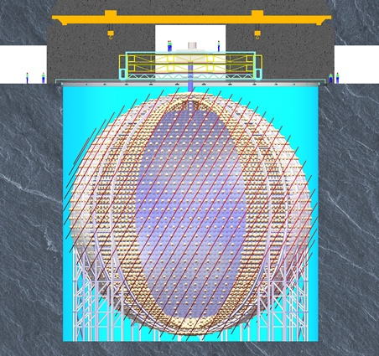
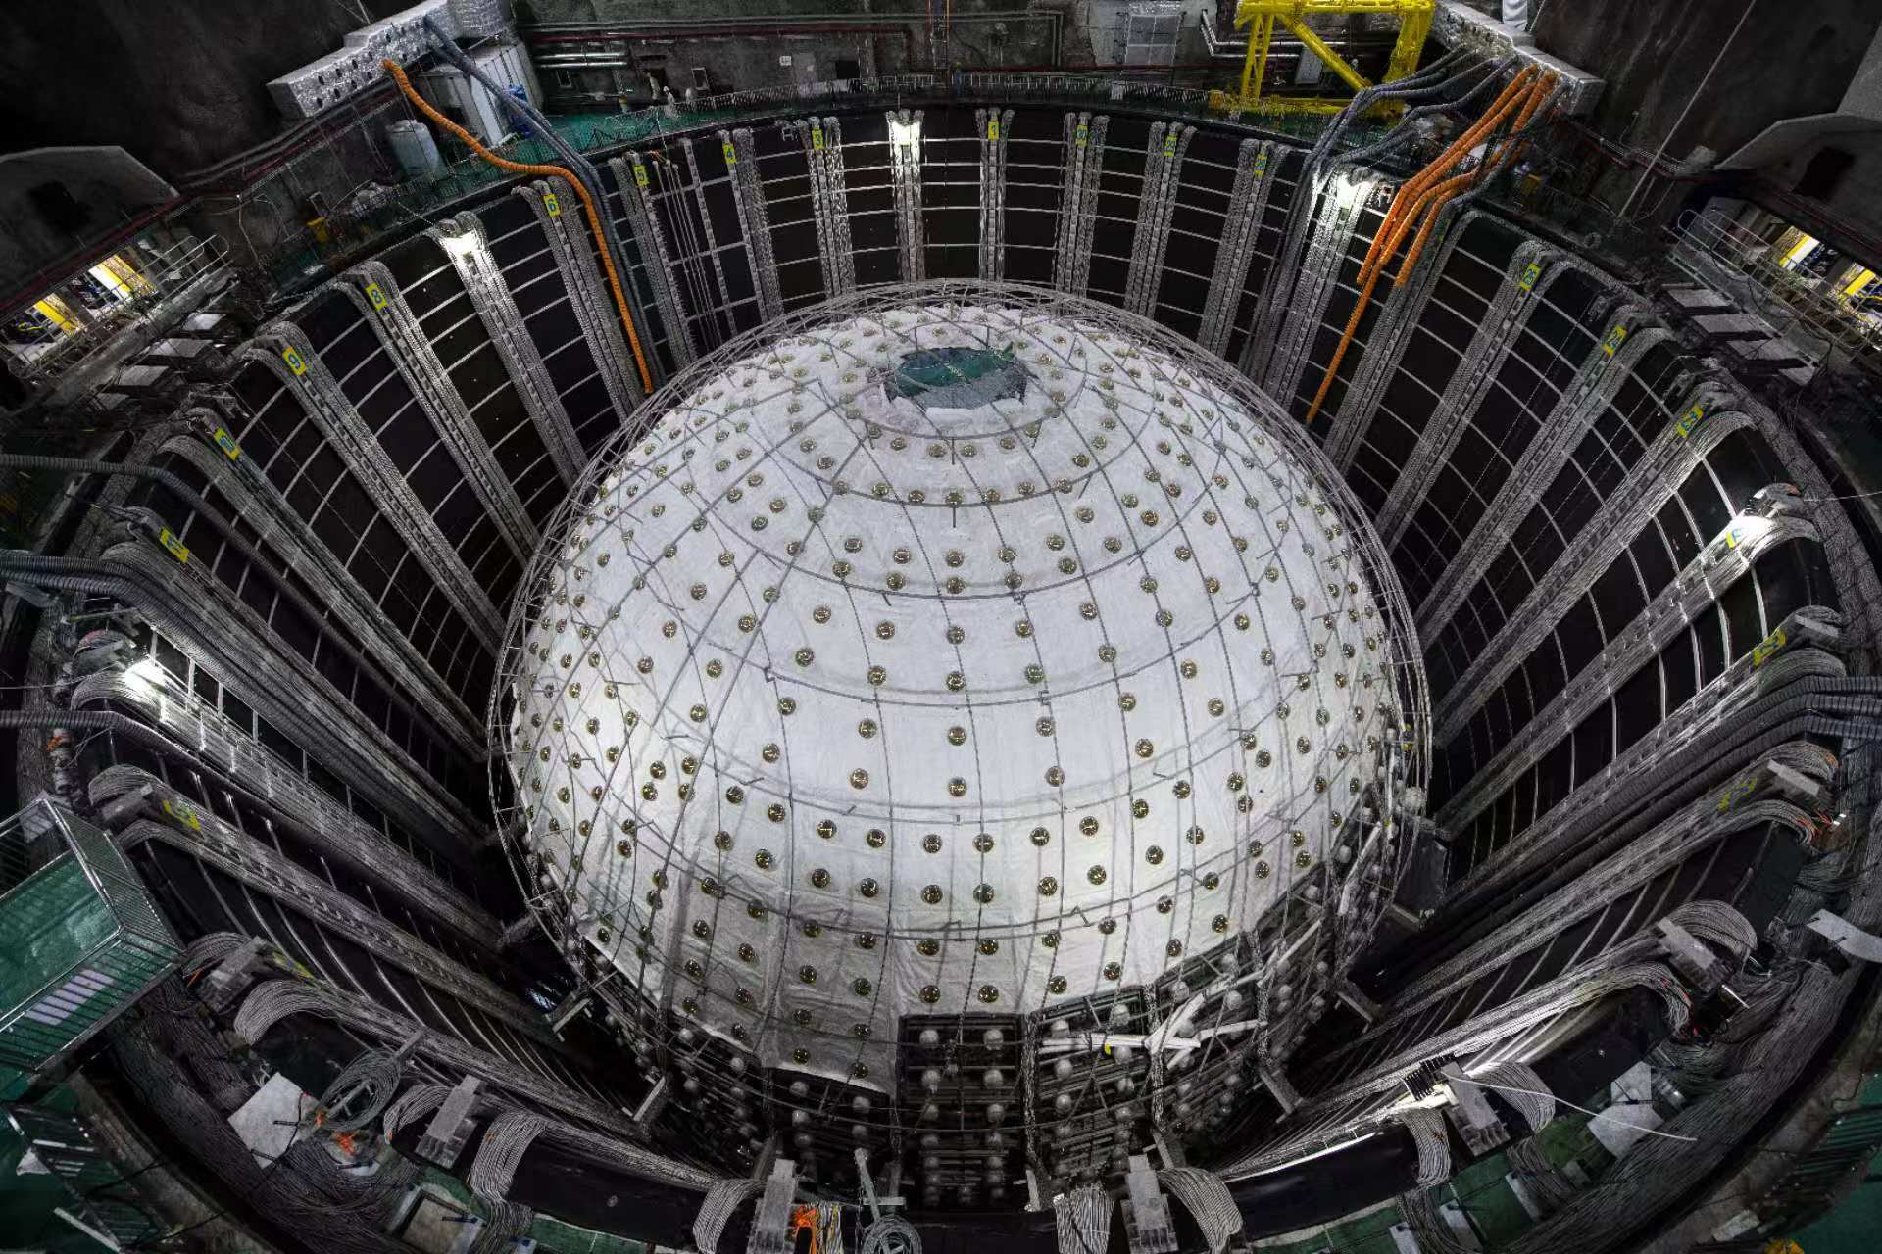
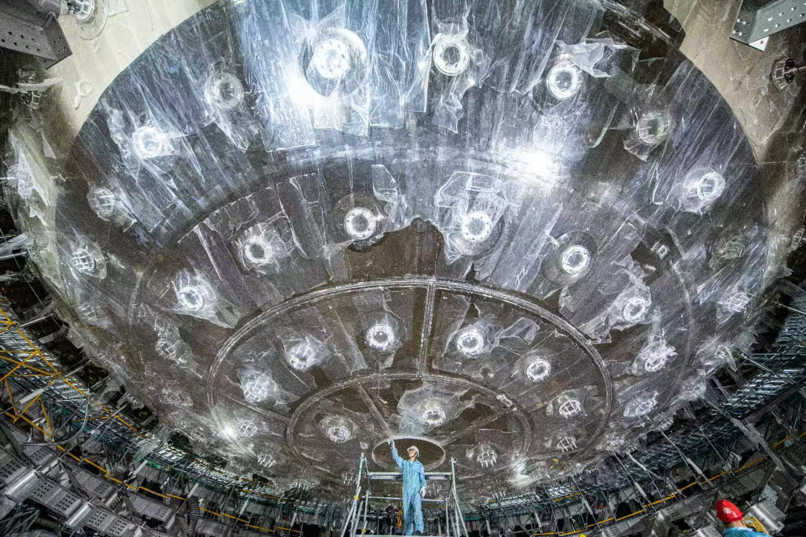
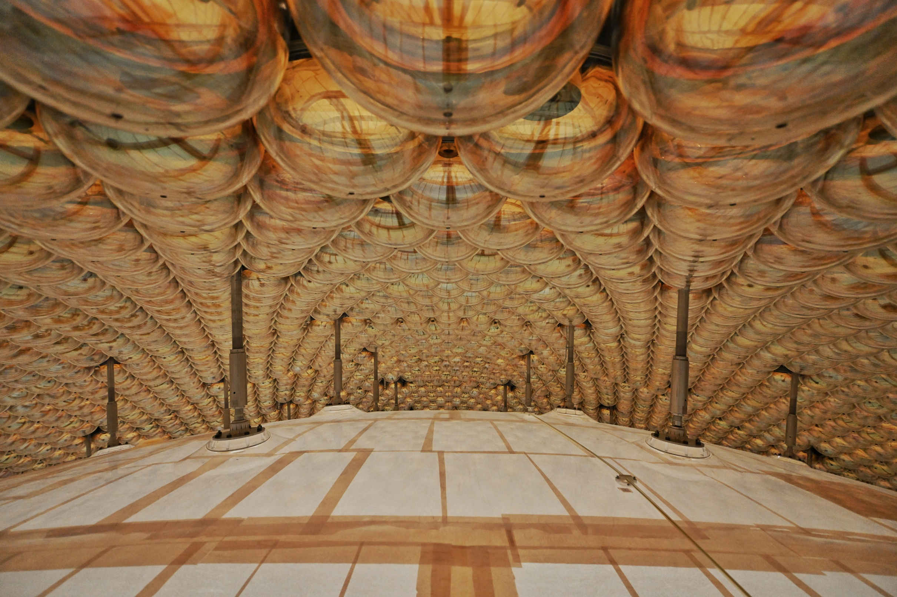
JUNO Detector Installation is its end
Calibration
VETO system
Top Tracker
Water VETO with ~2400 20’’ PMT
Earth Magnetic Field shielding coils
Central detector
Steel structure (SSS)
Acrylic sphere(AS) +20kt Liquid scintillator
~17612 20” PMT
~25600 3’’ PMT
Water Pool
depth: 44m
diameter: 43.5m

Slide 2
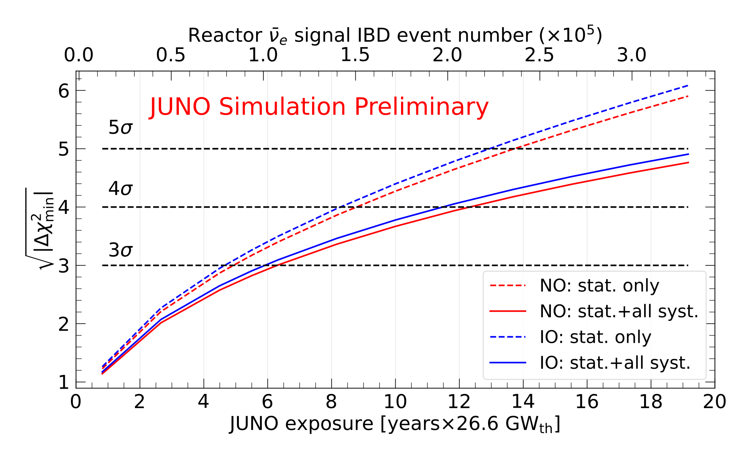
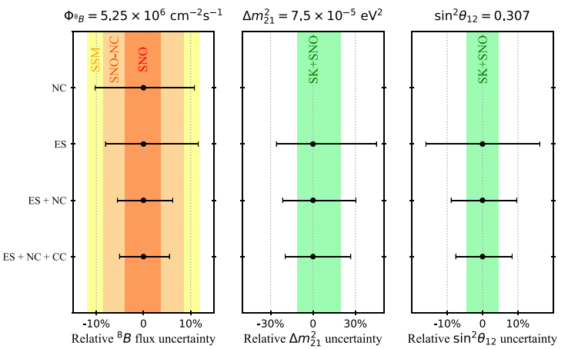
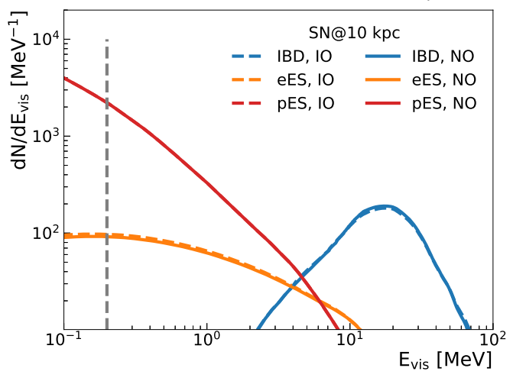
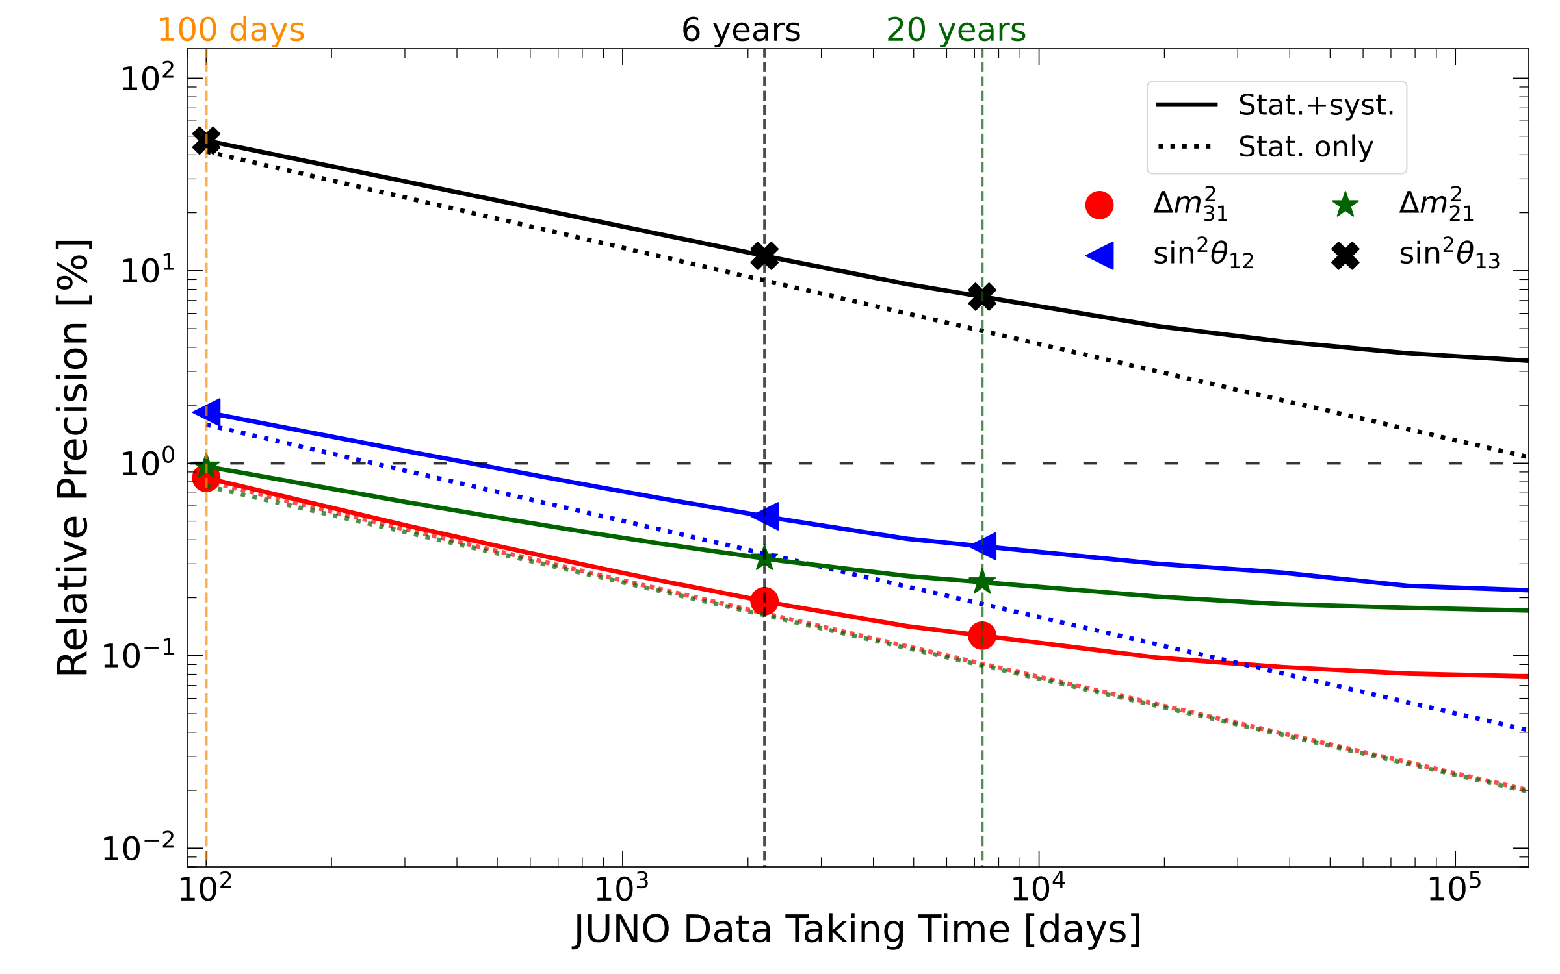
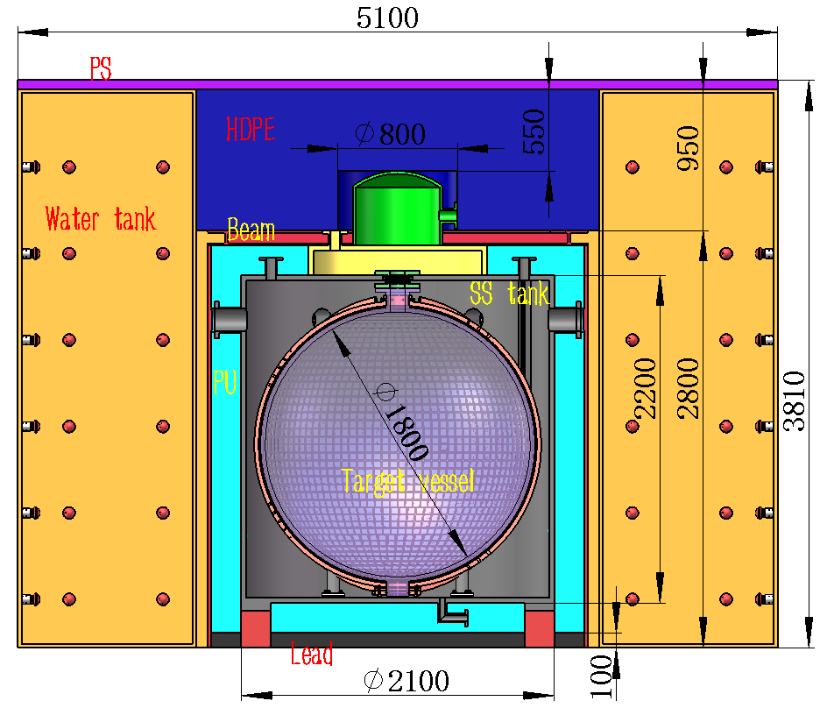
JUNO Physics Prospects
Mass Ordering dtermination
Solar Neutrinos
SN Neutrinos
3σ sensitivity within ~ 6 years, Independent of $θ_{23}$ and $δ_{CP}$
Three detection channels sensitive to all flavors
Excellent capability for early warning
60,000 ES and 600 NC/CC on ¹³C，The largest ¹³C ES+NC+CC sample, ⁸B flux can be model-independently measured to 5% in 10 years (SNO 3%)
Construction in Taishan NPP started in September, 2024
10 m² SiPM + 2.8 ton Gd-loaded LS @-50℃
Energy resolution: ~1.5%/√E, 4500 p.e./MeV
700k neutrinos/year@44m from the core (4.6 GW), with ~10% bkg
Measure $\sin^{2}θ_{12}$, $Δm_{21}^{2}$ and $Δm_{31}^{2}$ to better than 0.5% in 6 years
JUNO-TAO, detector beside reactor core

